Slide 1
MANAGEMENT ONE’S PROPERTY MANAGEMENT SERVICES
Powered by
MANAGEMENT ONE
BRE#01096906

Slide 2
Management One’s - Knowledge and Experience
Ron Sudman
We’ve leased, rehabbed and managed over 10,000 homes in the last 31 years
Over 3,000 Owners have trusted us with their investment
Last year we increased rents and put $475,000 into owner pockets
We have the experience and knowledge to rent and manage your property

Slide 3
Organizational Chart
CEO/President
Manager
Business
Development
Marketing
Leasing
Accounting
Quality
Assurance
Maintenance
Legal
Customer
Service

Slide 4
We Rent Your Property, But Manage Much More
Manage the
Property
Manage the Resident
Manage your Cash Flow
Manage the Legalities
Manage the Protection of Your Property
Manage all the Maintenance & Vendors

Slide 5
How Are We Different? We Changing The Culture
We Changed the Culture of
Property Management
“Like Starbucks did with coffee”
01
02
03
Stylish
Upbeat
Inviting

Slide 6
Services Management One Provides

Slide 7
Our Time-Tested Process To Rent Your Property
STEPS

Slide 8
Strategy To Get Top Rent Quickly
Price Rental Rate
How A Property Shows
How It’s Marketed

Slide 9
Step # 1 - Setting the Rental Rate
Price - Rental Rate

Slide 10
Step # 1 Strategy To Evaluate And Set Your Rental Rate
Rented properties with quality Management One residents
Rented properties in the open market place
Your time frame on when you need your property rented

Slide 11
Certified Rental Analysis
Certified Rental Analysis

Slide 12
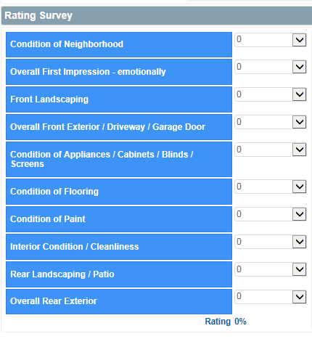
Property Condition Must Match Rental Rate
Property Condition
Rent Rate
Rents Your
Property Quickly

Slide 13
Pricing Algorithm To Rent Quickly
Priced Right – Applications In The
First Week
Showings & No application = 4-6% off – 14 days
Low Showings = 6-10% off – 30 days
Drive-by only; no showings = 10-12% off - 45 days

Slide 14
Step # 2 - Setting The Marketing Strategy
Preparing the property for the rental market
Staging your property
Prospective residents previewing properties

Slide 15
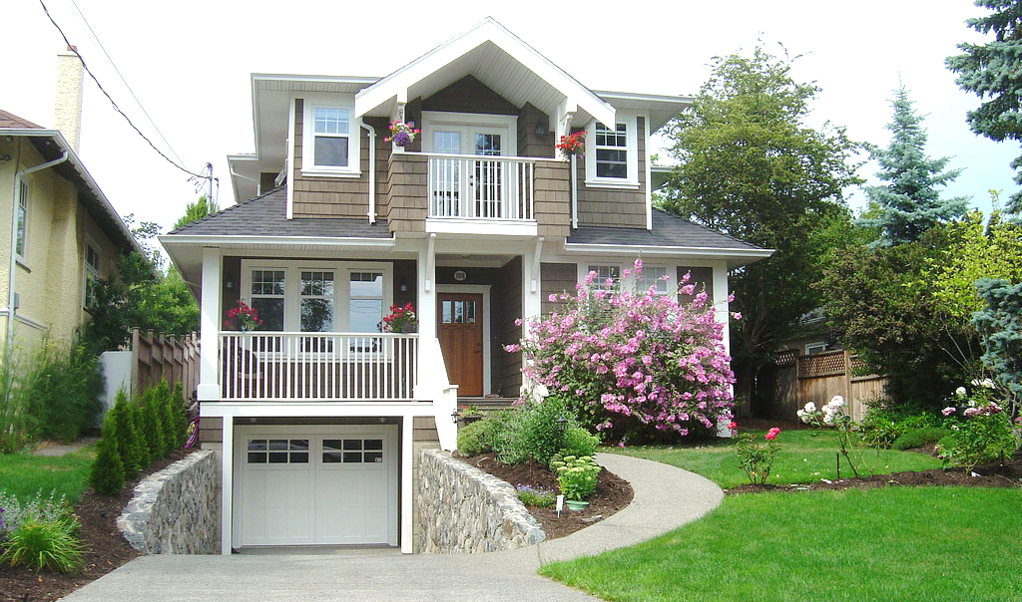
Staging The Property
Focus Groups Are The Key
1
3
Our focus groups tell us that the FRONT of the property and especially LANDSCAPING is most important
2
SMELL is third most important
CLEANLINESS is second most important

Slide 16
Step # 3 - How Your Property Is Marketed To New Residents

Slide 17
How Renters Found Their Property To Rent
Know The Market
Percent of Residents Surveyed
41,303 Residents surveyed stated PRICE was the number one thing they look at
Internet
Driven By- For Rent Signs
Refferrals
Social Media

Slide 18
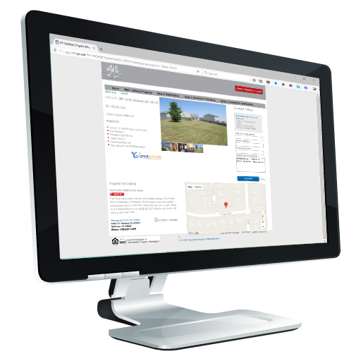
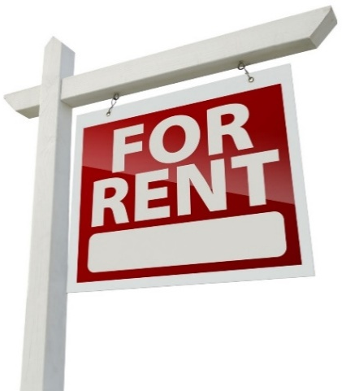
Marketing Specialist 10,000 Homes Strong
Direct to Current Residents
Social Media
Agent to Agent
Your Property
Action For RENT Signs
Search Engines
National On Line Marketing

Slide 19
Agent to Agent
Board of Realtors meetings
Electronic Flyers
Management One strategically advertises your property in several publications
MLS to thousands of Brokers/Agents
We Pay Up to $300

Slide 20
Company Direct to Current and Prospective Residents
Extended Market
Over 7,000 current, past and prospective Management One residents
We Pay referral fees to Agents who refer a NEW confirmed resident

Slide 21
Search Engines; Google, Facebook, and Yahoo

Slide 22
How We Rent Your Property Faster with our 24/7 Renters Scheduling System
New residents can
schedule a viewing
themselves 24/7
80% of residents
want to schedule
Our Renters System RENTS Your Property 25% Faster
90% want to view
Vacant properties
Residents are cleared
Residents view vacant
properties 7am to 10 pm
7 days a week and Holidays
Residents are texted 2hrs
prior to confirm showing
Residents are contacted after viewing
property to fill out an application

Slide 23
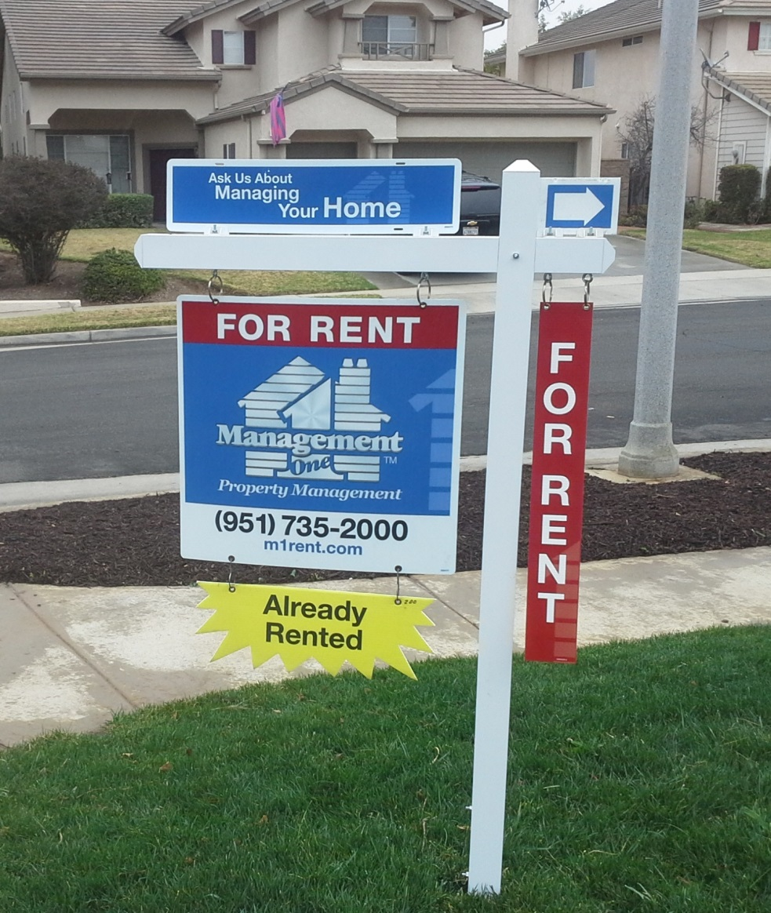
Action For Rent Signs
How to get your property rented quickly?
Professional “For Rent” signs increase your exposure
38% of residents surveyed said they drive by the properties to find a property to rent

Slide 24
Keep Your Residents With Sufficient and Qualified Staff
100-Day training requirement
Written testing requirements and must have 90% rating or higher to work on your properties
Advanced training in each division every month
Knowledgeable and Experienced Staff Reduces Your Vacancies!

Slide 25
Managing The Resident
Resident Orientation Celebration
Long term residency starts with building rapport
Paying on time is expected & this is expressed in detail with new resident
Welcome
Paul & Stacey to Your New Home
Resident are to take care of your property

Slide 26
Timely Customer Service = Long Term Residencies
The truth about creating a long term residency
The biggest reason residents move is because of maintenance, not rent increases
Email survey is sent to the resident 14 days after work order is issued to check:
Did the repairman show up on time?
Was the repair completed 100%?
Did the repairman clean up after the repair was made?
Poor customers service creates higher turnover of your residence

Slide 27
Owners Estimate Of Fees For Services
Good Faith Estimate, Fees and Agreement

Slide 28
Perceived Services Compared To Actual Services
Set The Rental Rate
Inspect and Make Property Rent Ready
Set up all Internet and media advertising
Be a student of the Rental Market
Comply with all Fair Housing Laws
Draw up all Lease Agreements and Mod’s
Take Renters calls in middle of the night
Manage repairs
Take photos of repairs before and after
Security Deposit disbursements
Exterior Inspections (monthly) with photo
Annual Inspections; 15 page report with photos
Post violations notices on resident property
Review & raise rents
File 3-Day notices
File covenant breach
Video property
Install “For Rent” sign
1099 tax statement
File Evictions and manage process
Court Appearances
Mail rent checks and statements
Prepare and send year in tax statements
And much more……
What Most Owners/Landlord Think We Do
Rent the Property
Collect Rent
Take a Repair call
once in awhile
Sent Owner Rent Check
What Management One Actually Does Is A
Whole Lot More

Slide 29
Fees for Services
Management One's Fees
Economy Package
Premium Package
AFFORDABLE
BEST VALUE
Basic Package with Options less your tax savings on the fee.
$99
PER MONTH
50% PLACEMENT FEE
$250 RESERVE
10%
PER MONTH
$495 PLACEMENT FEE
$250 RESERVE
$99
Rent collected
Monthly fin. statements
Video property
Install “For Rent” sign
Take photos
Internet advertising
1099 tax statement
Electronic checks & statements
Manage repairs
Take repair calls 24/7/365
Owner Login Portal
Rent collected
Monthly fin. statements
Video property
Install “For Rent” sign
Take photos
Internet advertising
1099 tax statement
Electronic checks & statements
Manage repairs
Take repairs calls 24/7/365
Owner Login Portal
Eviction Coverage
Court Appearances
Exterior Inspections (monthly) with photo
Annual Inspections; 15 pg report with photos
Post violations notices
Review & raise rents
File 3-Day notices
File covenant breach
Paid renter referral fees to agents
Mail rent checks and statements
Unlimited trips to property
Options!
Premium Package – offers full coverage for a 10% monthly fee, less your tax savings on the fee.
10%

Slide 30
Managing Your Cash Flow
Professional Property Management Pays Their Own Way!
$12,600
Year # 1 - $600
Year # 2 - $1,200
Year # 3 - $1,800
Year # 4 - $2,400
Year # 5 - $3,000
Year # 6 - $3,600
Total - $12,600
Example:
Raise RENT $50.00 a month per year and it puts $12,600 more in your pocket in 6 years
Repairs will come, we will build your nest egg in advance

Slide 31
Your Management Agreement And How Your Management Fee Is Used
Fees for full services at 10% management fee
$
10%

Slide 32
Management One Fees
Management fees goes to staff salaries
4%
Leaving the company with
6% in management fees
6%

Slide 33
Management One Fees
Let me share with you how the 6% is divided up
6%

Slide 34
Management One Fees
2% goes to
Operations, Insurance,
Technology, Overhead, etc.

Slide 35
Management One Fees
1% goes to marketing

Slide 36
Management One Fees
The Company receives
3%

Slide 37
Actual Fees Management One Receives
1 ½ % goes to IRS and State Taxes
1 1/2%
Leaving 1½ % to the company

Slide 38
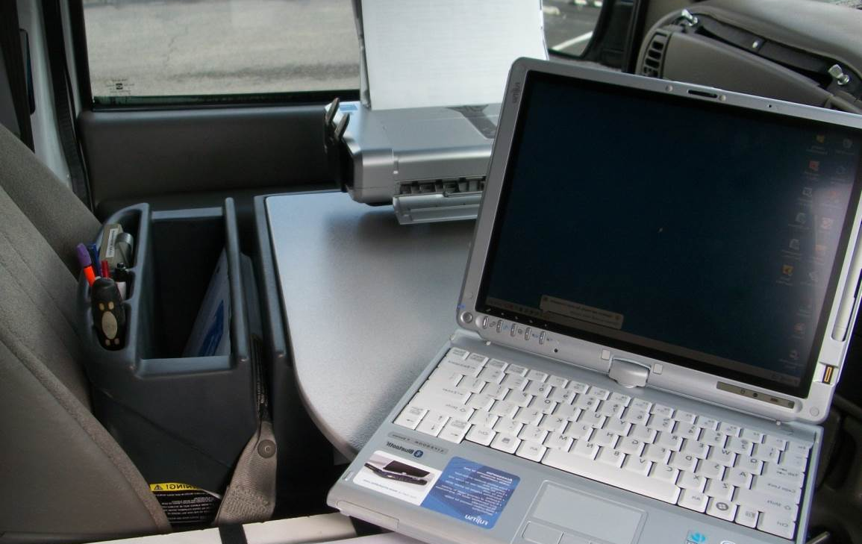
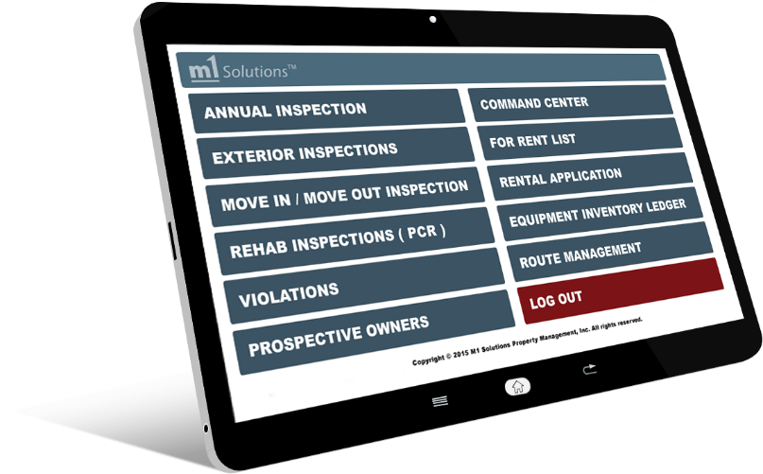
Managing the Maintenance and Vendors
Property
Inspections
Monthly exterior inspections with photo
Reduces violations 80%
Residents are fined $50, $150, $250 for violations. Fines increase if not corrected

Slide 39
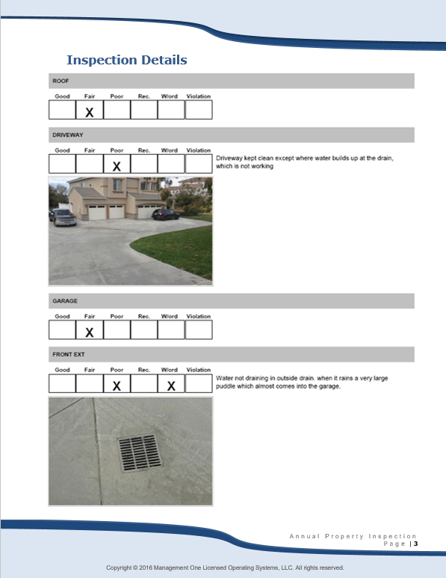
Property Inspections
Property Inspections
Annual inspections
This is a remarkable report.
We have a scheduled appointment with your resident each year
You are sent a 15 page report with the condition of each room and exterior

Slide 40
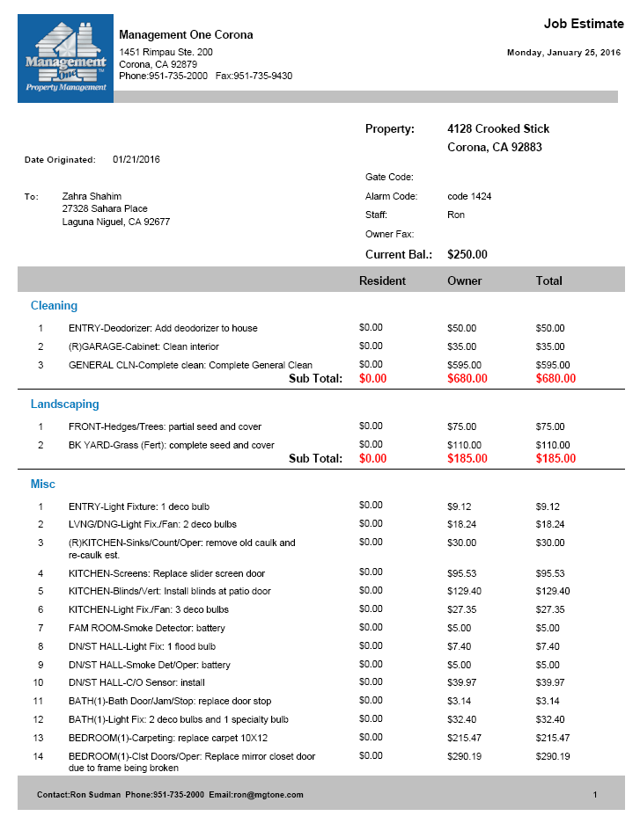
Property Inspections - Between Residents
Job Estimate
You receive a detailed estimate with prices prior to work being done
01
Then it’s ready for the next resident
05
02
You remit the funds
Job Estimates Process
04
03
Work is done by Vendors in 5 days or Yourself
Then we re-inspect property to check all work completed

Slide 41
Maintenance Repairs - No Mark Up Pre-set “Maintenance Price List” on 600 Items to reduce days property is vacant
Description
Category
Brand
Quality
Labor Hrs.
Labor Cost
Material Price
15% Mat’I New Mark up
New Tax
Service Call
Add-On $40.00
Warty
Mat
Warty
Labor
GARBAGE DISPOSAL HP 3/4 | Plumbing | Badger | DELUXE | 1hr 15min | $ 61.25 | $139.00 | $20.85 | $12.16 | $233.26$ | 1 Year | 1 Year
FAN/BATHROOM | Plumbing | NUTONE | DELUXE | 1hr | $49.00 | $35.68 | $5.35 | $3.12 | $93.15 | 120 Day | 120 Day
SINK/KITCHE | Plumbing | NEPTUN | ECONOM | 2hr 30min | $122.50 | $99.00 | $14.85 | $8.66 | $245.01 | 5 Year | 5 Year
With our fixed price list we control your maintenance repairs and reduce overcharges

Slide 42
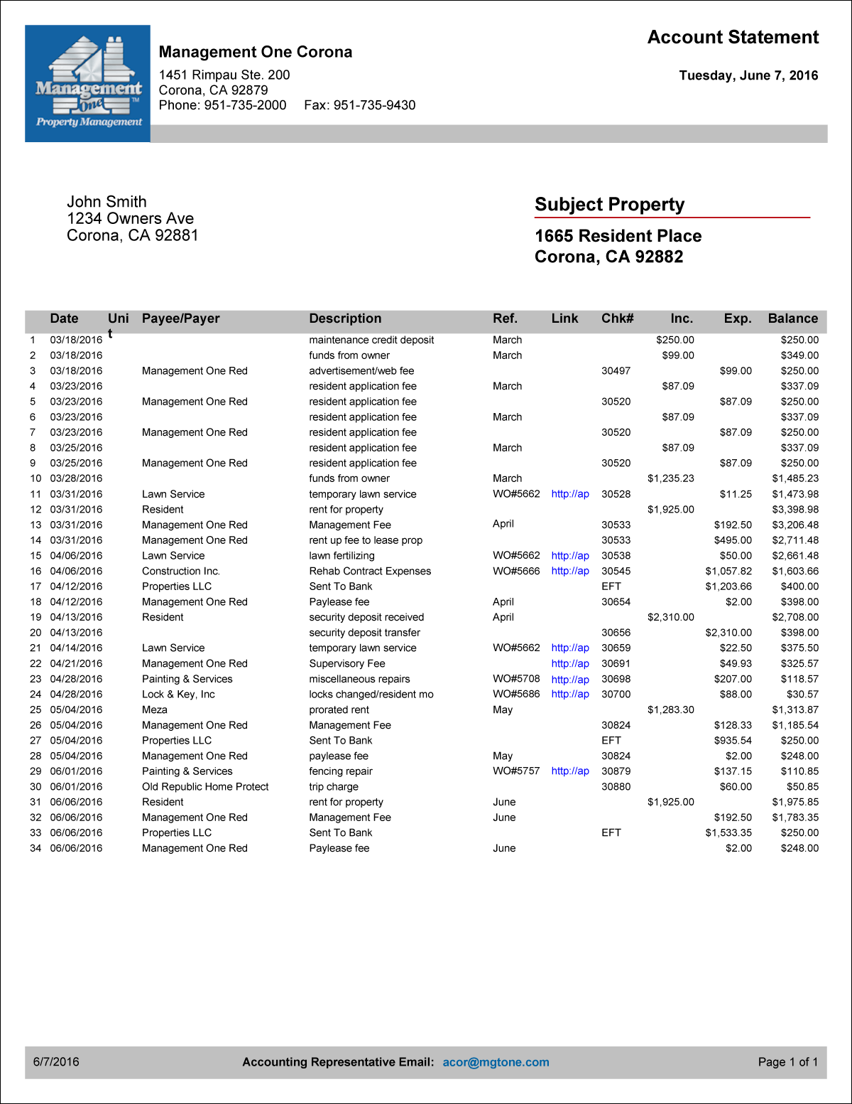
Rent Payment Process (Includes invoices on hyperlink and photos of repairs)
Rent Check Includes:
Rent collections
Monthly accounting statement
Year end tax statement
View personalized owner portal
24/7/365

Slide 43
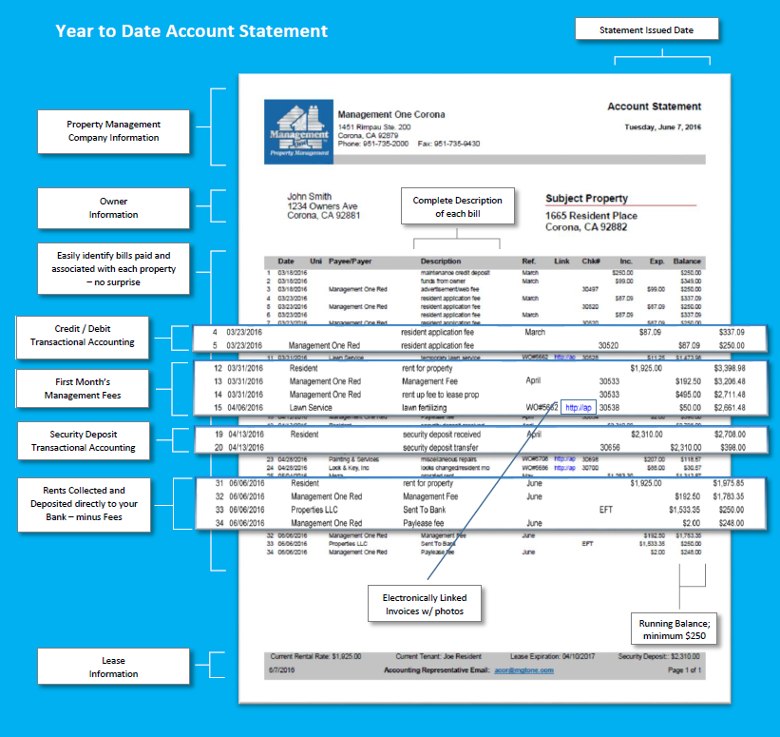
Financial Statements
Monthly Owner
Statement
Electronic Access
Year-to-Date
Cash flow Statement
Year-End 1099

Slide 44
Managing The Legalities Of Your Investment
Gross household income must be
3 x rent rate
Debt to Income (55%-65%)
Check Credit
for delinquencies & pay pattern
Qualifying Process
Check Court Records for Evictions, BKs, Foreclosures, Judgments
Employment Verification
Current only
If you have an eviction, you don’t pay the
$800 - $1200
Landlord Verification
Current & Previous
Our eviction rate on over 10,000 properties is less than 1%
WE DO on premium service !
FICA scores are not reliable

Slide 45
Managing The Protection Of Your Property
Malicious Intent
Protects you if the resident damages the property above normal wear and tear. Only 1% of self managers know this
Landlord – Resident Property Insurance
Loss of Rents
Pays you your monthly rent up to a year if the property burns down or has severe damage by the resident
Vandalism
Covers damages if someone breaks in or steals items. This coverage is not valid after being vacant for 30 days
A Homeowner policy is NOT the policy you want.
You will pay more and have a lot less coverage.
Fire Liability
Your standard coverage like a homeowner policy

Slide 46
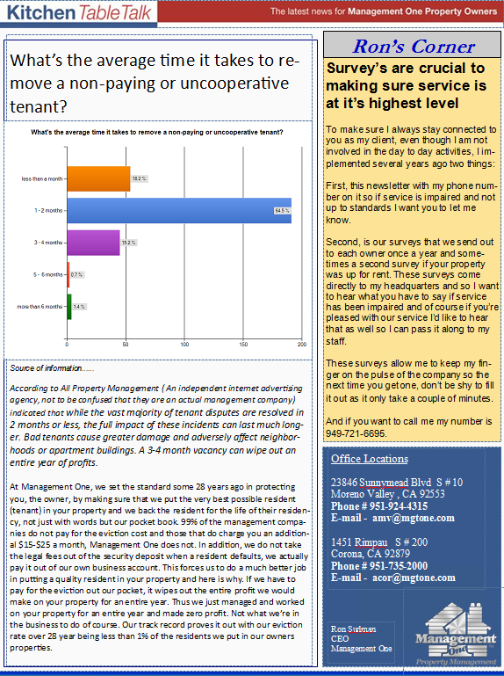
Connection With You
Newsworthy
Owner Investor Newsletter
Amazing it’s been written for 22 years and we’ve never missed a month.
You can view on your phone, tablet, desktop or in the mail.

Slide 47
Partnership Agreement
Management One
Manages the resident
Manages cash flow
Leasing
Repairs
Inspections
Accounting
Owner
Move out of property as agreed if currently living in property
Remit funds timely when needed
Respond within 48hrs of contact
Obtain the proper property insurance
04
01
Vendor
Must be licensed & insured
Must give timely service to resident
Give estimates as needed
Agree to our pre-set maintenance pricing
03
02
Resident
Maintain property
Pay rent on time
Notifies us of repairs

Slide 48
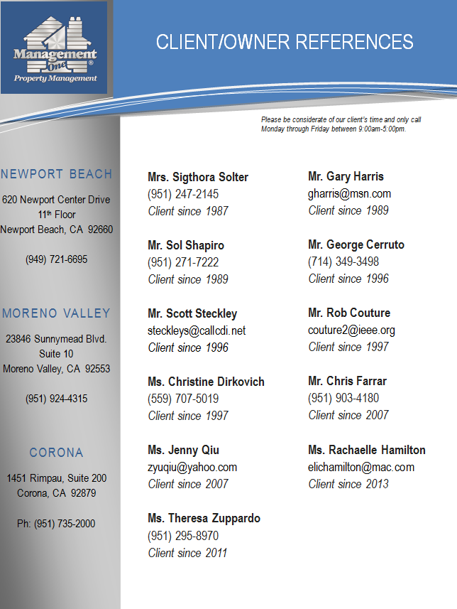
Testimonials from our current clients

Slide 49
You Give Us The Keys, We’ll Do The Rest!

Slide 51
Hidden Management Fees Self Manage (vs) Professional Management
Six Year Management Fee Comparison
Your Losses |  | Prof Mgt Fees
 | Professional management fee $150 per month | $ 10,800.00
$ 1,500.00 | Same quality resident. One month longer to rent, you have no pipeline | $ -
$ 6300.00 | 95 % of Landlords who mange themselves do not increase rents | $ (6300.00)
$ ? 400.00 | Rehab property to set up to rent – Your Time - 20 hrs at $20 per hr | $ Included
$ ? 2,880.00 | Your Time it takes to manage each month avg - 2hrs/$20 hr | $ Included
 | (Drive by property monthly, annual inspections plus gas) | $ Included
$ - | < NO Tax write off on management fee - Fed-State 30% YES > | $ (3,240.00)
No | Eviction coverage $800.00 -$1200 | Included
No | Rent up fee, lease renewal, supervisory fee | 2435.00
No | Respond to resident on repairs within 4hrs to reduce vacancies | Included
Yes | Residents have to work around your schedule | No
$ 11,080 .00 | < Total Amt of money Total Net Mgt fee you will lose over 6 years over 6 years>>>>>>>> | $ 3695.00
$ 1846.66 | < Amt you will lose Net Mgt Fee per each year year >>>>>>>>>>>>> | $ 6151.83
$ 153.83 | < Amt you will lose Net Mgt Fee per each month doing it yourself Month with Mgt One > | $ 51.31
If YOU are managing it cost you this
Professional Property Management Doesn’t Cost, it PAYS!
If Company manages it cost you this and you do no work

Slide 52
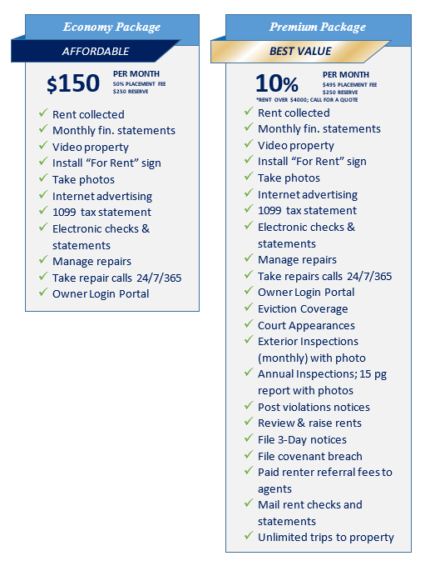
Fees for Services
Management One's Fees
$150
Basic Package with Options less your tax savings on the fee.
Options!
Premium Package – offers full coverage for a 10% monthly fee, less your tax savings on the fee.
10%

Slide 53
Fees for Services
Management One's Fees
Economy Package
Premium Package
AFFORDABLE
BEST VALUE
Basic Package with Options less your tax savings on the fee.
$500
PER MONTH
50% PLACEMENT FEE
$250 RESERVE
7-10%
PER MONTH
$495 PLACEMENT FEE
$250 RESERVE
$500
Rent collected
Monthly fin. statements
Video property
Install “For Rent” sign
Take photos
Internet advertising
1099 tax statement
Electronic checks & statements
Manage repairs
Take repair calls 24/7/365
Owner Login Portal
Rent collected
Monthly fin. statements
Video property
Install “For Rent” sign
Take photos
Internet advertising
1099 tax statement
Electronic checks & statements
Manage repairs
Take repairs calls 24/7/365
Owner Login Portal
Eviction Coverage
Court Appearances
Exterior Inspections (monthly) with photo
Annual Inspections; 15 pg report with photos
Post violations notices
Review & raise rents
File 3-Day notices
File covenant breach
Paid renter referral fees to agents
Mail rent checks and statements
Unlimited trips to property
Options!
Premium Package – offers full coverage for a 10% monthly fee, less your tax savings on the fee.
10%

Slide 54
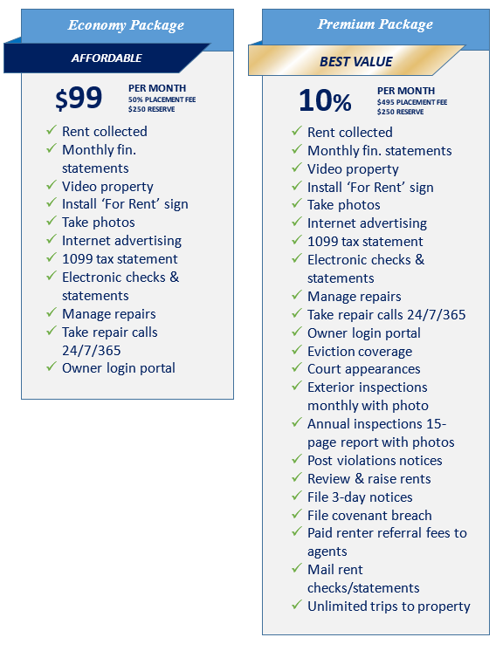
Fees for Services
Management One's Fees
$99
Basic Package with Options less your tax savings on the fee.
Options!
Premium Package – offers full coverage for a 10% monthly fee, less your tax savings on the fee.
10%

