Slide 1
MANAGEMENT ONE’S PROPERTY MANAGEMENT SERVICES
Powered by
MANAGEMENT ONE
Property Management

Slide 2
Management One’s Knowledge and Experience
We’ve leased and rehabbed over 10,000 homes in the last 31 years
Over 3,000 Owners have trusted us with their investment
Serviced several thousands of Residents
We have the experience and knowledge to rent and manage your clients properties successfully

Slide 3
Management One Property Management
Benefits & Protection to YOU the Broker/Agent

Slide 4
Broker/Agent Services and Protection
How We Protect Your Listing Rights on Owners You Refer

Slide 5
Property Protection
Your listings are protected in writing

Slide 6
Client Protection
If your client purchases more properties or list other properties they have, you get the sales and Commissions backed in writing

Slide 7
If The Resident Ever Buys The Property You’re Guaranteed A Commission
We changed the Culture in Property Management At Management One
If the Resident, we rent the property to, buys it; you’re Guaranteed a minimum 4% Commission backed in writing

Slide 8
Broker/Agent Services and Protection
Referral Fees

Slide 9
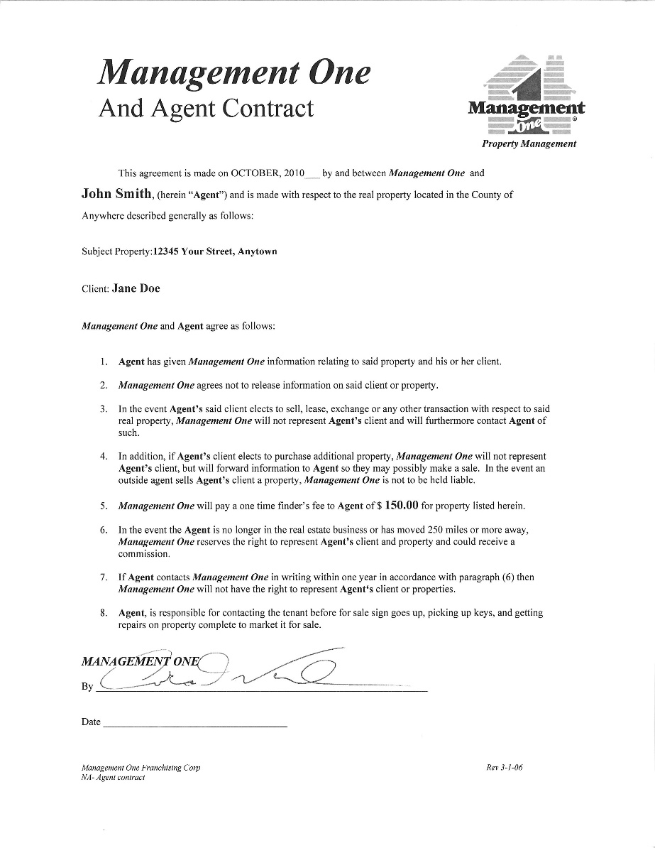
Referral Fees Backed In Writing
Owner Referral Fee $320
$200 up front when management agreement is signed and a
$10 Starbucks card each month for one year
Resident Referral Fee $100-$300 depending on property. We do the showing and qualifying, not you.

Slide 10
Broker/Agent Services and Protection
Other Services You Receive

Slide 11
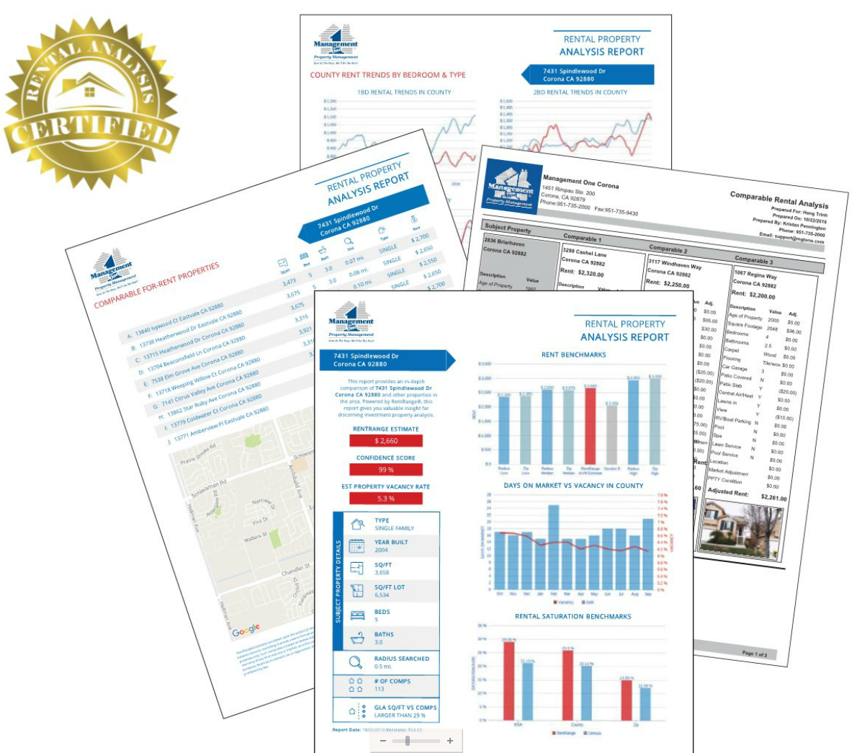
Comparable Rental Analysis – for you the agent MLS & internet are 15% higher than what they rent for
4 Factors
Rental Rate
Length of Lease
Security Deposit Amount
Qualifying of Resident

Slide 12
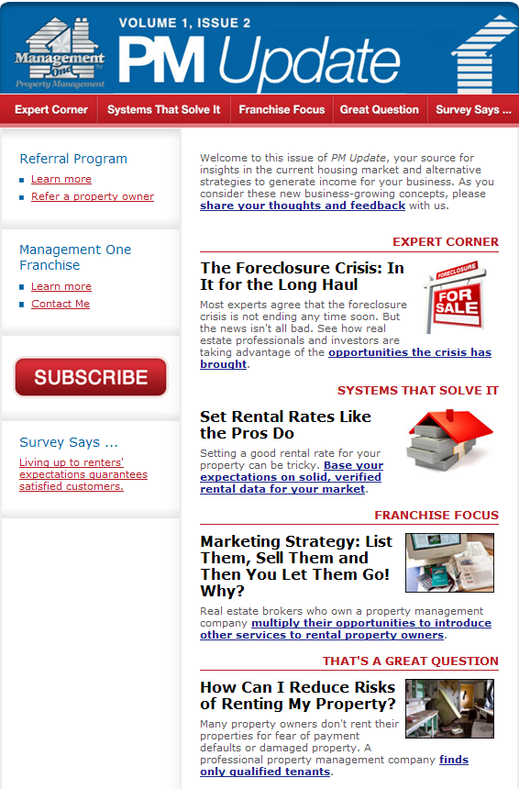
Complimentary Monthly Rental Property and Investment Newsletters
Broker/Agent Newsletters
Your Clients Receive a Monthly Newsletters

Slide 13
Wrapped up in one neat tool box
Just another tool in your Tool Box

Slide 14
Complimentary Rental Property and Investment Webinars For You and Your Clients
Topics
How to use your IRA to buy Real Estate (Trillions in IRA’s)
How to protect your property from resident damage
Asset Protection
1031 Exchanges
How to track your Investment
easily on a tablet

Slide 15
Our Property Management Services for Your Owners

Slide 16
How Are We Different ?
7 Guarantee’s
1. Response Guarantee: If you call and we don’t respond to you via phone or email within 24 business hours or less we will waive that months management fee
2. Our Fee Guarantee: If you find a lower fee we will match it and give another 5% off the monthly management fee
3. Resident Guarantee: We will pay for the eviction, attorney and court cost if resident defaults for any reason for life of resident. Our eviction rate is less than 1% on 10,000 properties rented
4. Rent Processing Guarantee: If we don’t mail your rent within 5 business days of receipt of the rent we will waive our management free for that month
5. Marketing Guarantee: We will call you each week when your property is up for rent or we will waive our management fee when the property rents. In addition we will email out to over 7000 of our past, current, and prospective clients so your property rents faster
6. No Mark Up On Maintenance Guarantee: We not only guarantee that we will never make a mark up on repairs but we also have set pricing that our vendors must agree to so we keep your maintenance cost low. We will pay for the repair if we ever make a profit on maintenance, that’s how serious we are about keeping your maintenance cost in check
7. Inspections Guarantee With Photo: We will do an exterior inspection every month and take a picture of the front of the property so you can view on your portal and in addition we will do an annual inspection with multiple photos or we will waive our management fee that month

Slide 17
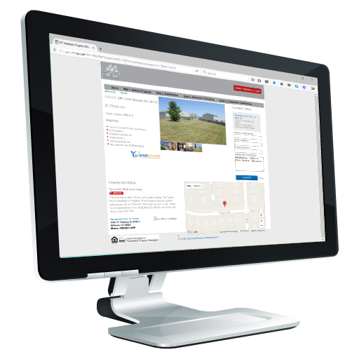
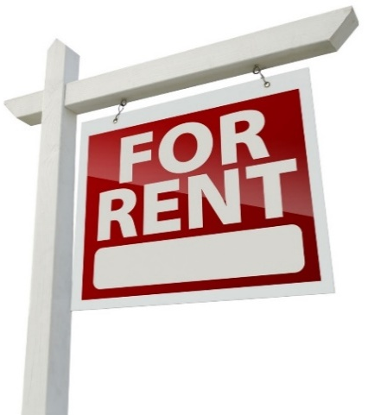
Marketing Your Clients Property
Direct to Current Residents
Social Media
Agent to Agent
Your Property
Action For RENT Signs
Search Engines
National On Line Marketing

Slide 18
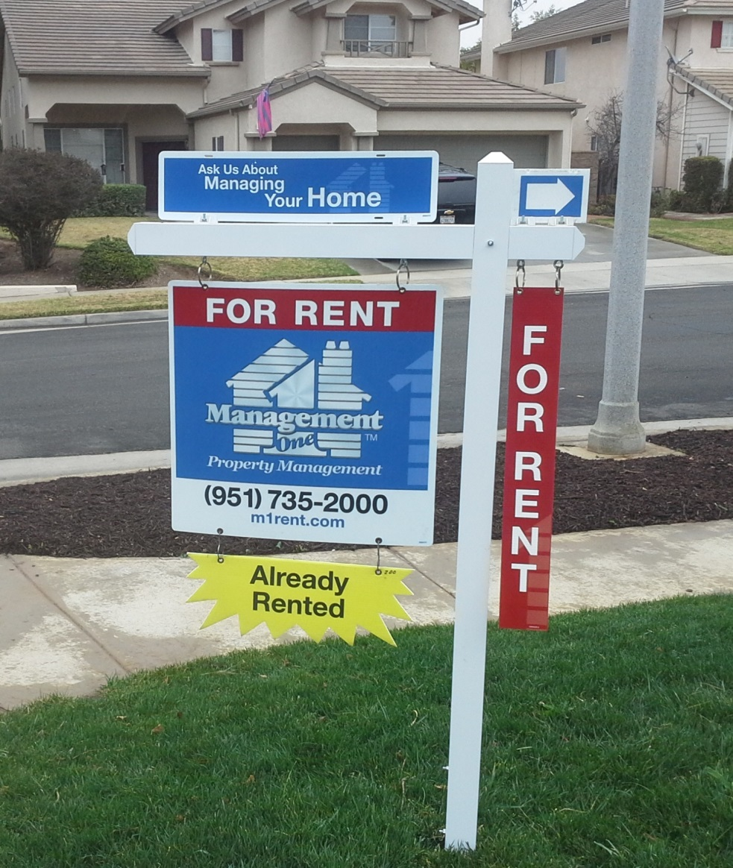
For Rent Signs
Signs still have a major impact
Professional “For Rent” signs increase your exposure
38% of residents surveyed said they drive by the properties to find a property to rent

Slide 19
Our 9 Point Screening Process
Gross household income must be
3 x rent rate
Debt to Income (55%-65%)
Check Credit
for delinquencies & pay pattern
Qualifying Process
Check Court Records for Evictions, BKs, Foreclosures, Judgments
Employment Verification
Current only
If you have an eviction, you don’t pay the
$800 - $1200
Landlord Verification
Current & Previous
Our eviction rate on over 10,000 properties is less than 1%
WE DO on premium service !
FICA scores are not reliable

Slide 20
Residents must pass our 9 point screening process We Pay for any Eviction for the life of the Resident

Slide 21
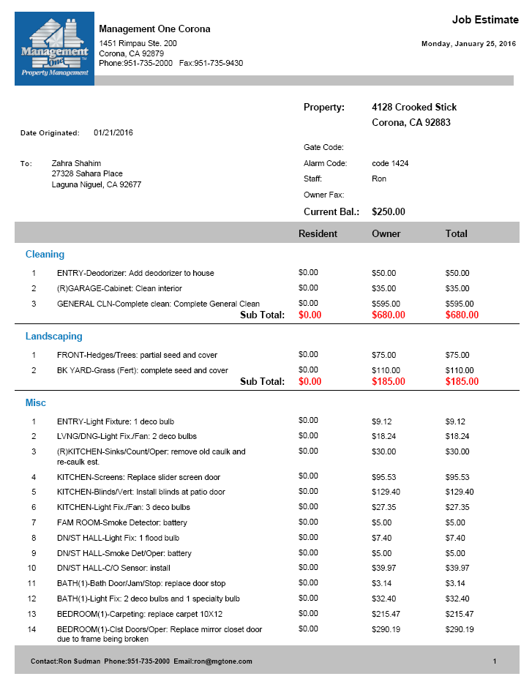
We Make the Property Rent Ready
Job Estimate
Your Owner receives a detailed estimates with prices prior to work being done
01
Then it’s ready for the next resident
Owner remits the funds
05
02
Job Estimates Process
04
03
Then we re-inspect property to check all work completed
Work is done by vendors in 5 days or yourself

Slide 22
Maintenance Repairs- No Mark Up
Pre-set “Maintenance Price List” on 600 items to reduce days property is vacant
Description
Category
Brand
Quality
Labor Hrs
Labor Cost
Material Price
15% Mat’I New Mark up
New Tax
Service Call
add on $40.00
Wrty
Mat
Wrty
Labor
GARBAGE DISPOSAL HP 3/4 | Plumbing | Badger | DELUXE | 1hr 15min | $ 61.25 | $139.00 | $20.85 | $12.16 | $233.26$ | 1 Year | 1 Year
FAN/BATHROOM | Plumbing | NUTONE | DELUXE | 1hr | $49.00 | $35.68 | $5.35 | $3.12 | $93.15 | 120 Day | 120 Day
SINK/KITCHE | Plumbing | NEPTUN | ECONOM | 2hr 30min | $122.50 | $99.00 | $14.85 | $8.66 | $245.01 | 5 Year | 5 Year
With our fixed price list we control your maintenance repairs &
reduce overcharges

Slide 23
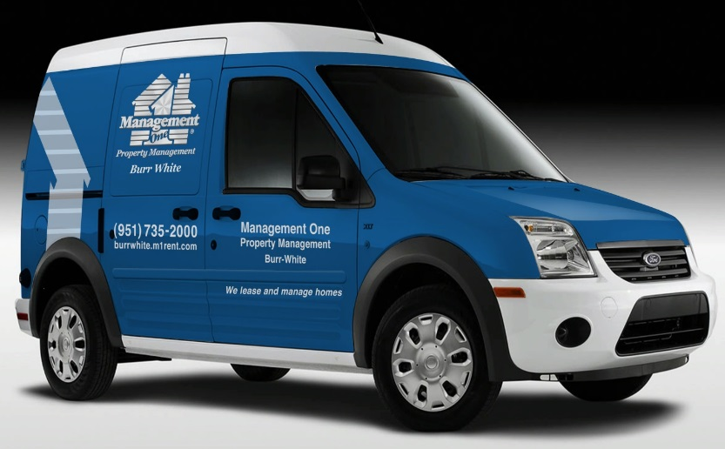
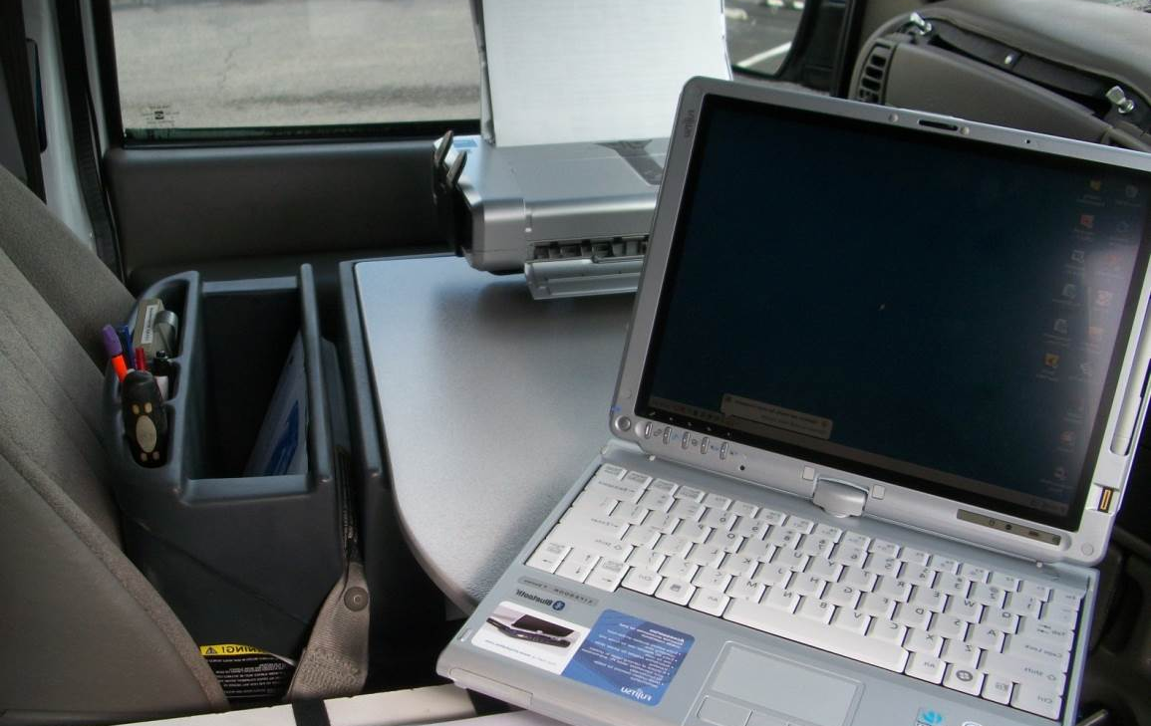
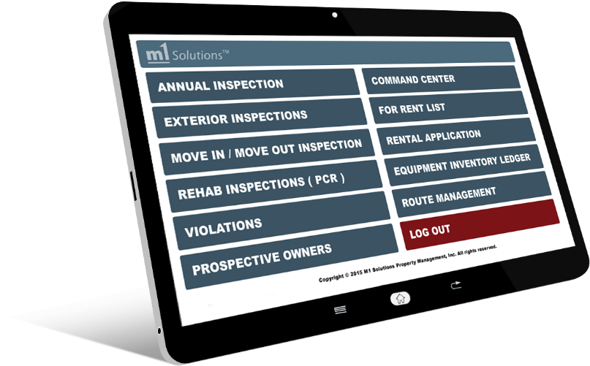
Monthly Exterior Inspections Keeps Residents Accountable
Property
Inspections
Owner receives monthly exterior photo
Reduces violations 80%

Slide 24
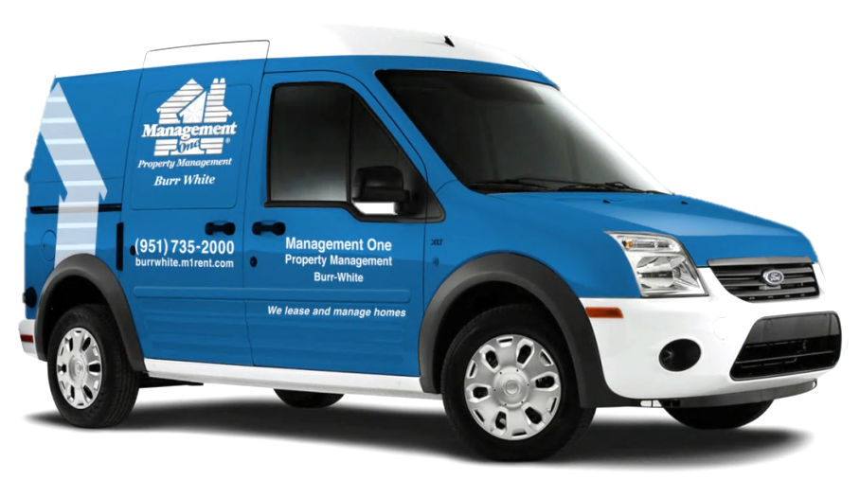
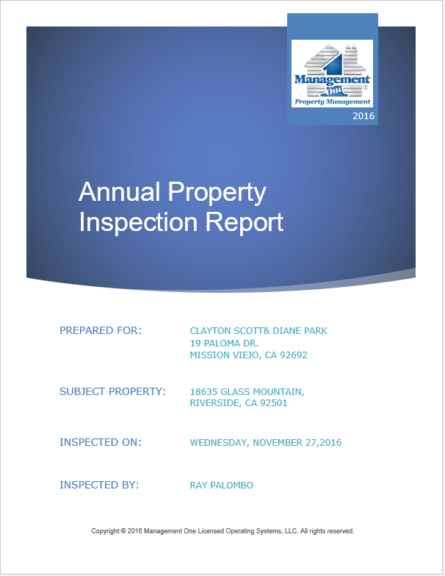
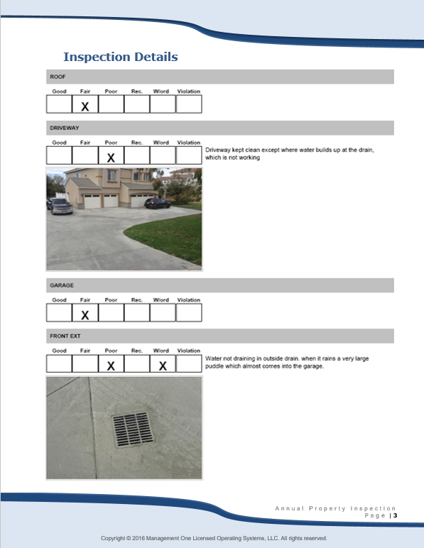
Annual Inspections Interior and Exterior
Property Inspections
Annual inspections
This is a remarkable report.
We have a scheduled appointment with your resident each year.
You are sent a 15-20 page report with the condition of each room and exterior.

Slide 25
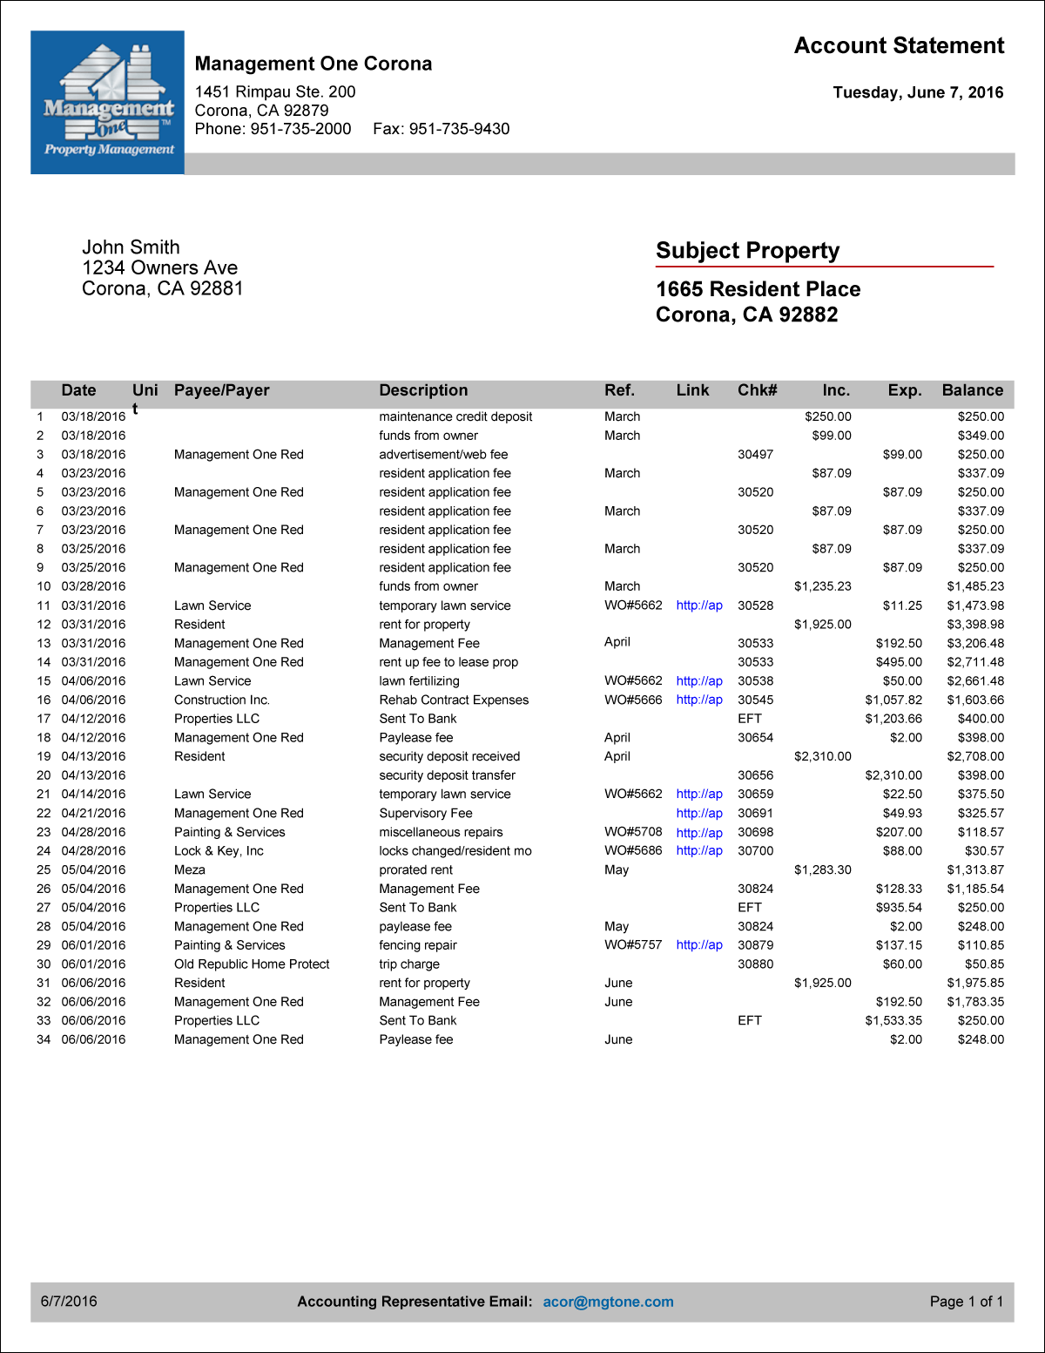
Rent Payment Process (Includes invoices & photos of repairs)
Rent Check Includes:
Rent collections
Monthly accounting statement
Year end tax statement
View from your owner portal on
your smart phone, tablet etc.

Slide 26
Fees for Services
Management One's Fees
Economy Package
Premium Package
Basic Package with Options less your tax savings on the fee.
1st year only, then 8% of rent minimum of $150
* 7 cents a sqft over 2000 sqft
AFFORDABLE
BEST VALUE
$99
$99
PER MONTH
50% PLACEMENT FEE
$250 RESERVE
* 7 cents a sqft over 2000 sq ft
10%
PER MONTH
$495 PLACEMENT FEE
$250 RESERVE
Rent collected
Monthly fin. statements
Video property
Install “For Rent” sign
Take photos
Internet advertising
1099 tax statement
Electronic checks & statements
Manage repairs
Take repair calls 24/7/365
Owner Login Portal
Rent collected
Monthly fin. statements
Video property
Install “For Rent” sign
Take photos
Internet advertising
1099 tax statement
Electronic checks & statements
Manage repairs
Take repairs calls 24/7/365
Owner Login Portal
Eviction Coverage
Court Appearances
Exterior Inspections (monthly) with photo
Annual Inspections; 15 pg report with photos
Post violations notices
Review & raise rents
File 3-Day notices
File covenant breach
Paid renter referral fees to agents
Mail rent checks and statements
Unlimited trips to property
Options!
Premium Package – offers full coverage for a 10% monthly fee, less your tax savings on the fee.
No- Eviction Coverage
No- Monthly Exterior Inspection
No- Annual Inspection
10%

Slide 27
Fees for Services
Management One's Fees
Economy Package
Premium Package
AFFORDABLE
BEST VALUE
Basic Package with Options less your tax savings on the fee.
* 1st year only,
* 7 cents a sqft over 2000 sqft
7%
7%
PER MONTH
50% PLACEMENT FEE
$250 RESERVE
Minimum $175 per mo
* 7 cents a sqft over 2000 Sqft
10%
PER MONTH
$495 PLACEMENT FEE
$250 RESERVE
Minimum $175 per mo
Rent collected
Monthly fin. statements
Video property
Install “For Rent” sign
Take photos
Internet advertising
1099 tax statement
Electronic checks & statements
Manage repairs
Take repairs calls 24/7/365
Owner Login Portal
Eviction Coverage
Court Appearances
Exterior Inspections (monthly) with photo
Annual Inspections; 15 pg report with photos
Post violations notices
Review & raise rents
File 3-Day notices
File covenant breach
Paid renter referral fees to agents
Mail rent checks and statements
Unlimited trips to property
Rent collected
Monthly fin. statements
Video property
Install “For Rent” sign
Take photos
Internet advertising
1099 tax statement
Electronic checks & statements
Manage repairs
Take repair calls 24/7/365
Owner Login Portal
No- Eviction Coverage
No- Monthly Exterior Inspection
No- Annual Inspection
Options!
Premium Package – offers full coverage for 10% monthly fee, less your tax savings on the fee.
10%

Slide 28
Managing The Resident
Long term residency starts with our 9 point screen process and building rapport
Paying on time is expected & this is expressed in detail with new resident
Welcome
Paul & Stacey to Your New Home
Resident are to take care of your property

Slide 29
Optional
*Start here if they are working with Investors*
**End here if they are working primarily with selling**

Slide 30
“Single Family Home” Retirement Strategy

Slide 31
Management One Property Management
How to put commissions in your pocket with the clients you have now
With our Wealth Building Strategies with “single family homes”

Slide 32
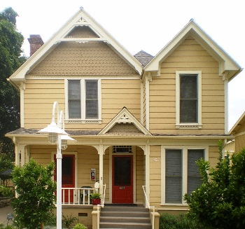
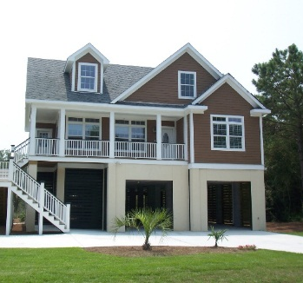
How Does It Work?
Our Amazing “Single Family Home” Retirement Strategy System
Owners control it, they own it,
You get the commissions
Owners can accumulate many properties or as little as they want
We train you step by step on this
SFHRS program

Slide 33
Tools We Have Available For You
Hold Book
Letter to mail out to your
Clients
Investment proprietary software
Scripts on what to ask
and say
Training on each screen
in the software
Make Ready
Maintenance Services
All forms, letters, etc.
Property management
services
Presentation package
for your client
CRA (competitive
rental analysis)
Marketing tools to
market to clients

Slide 34
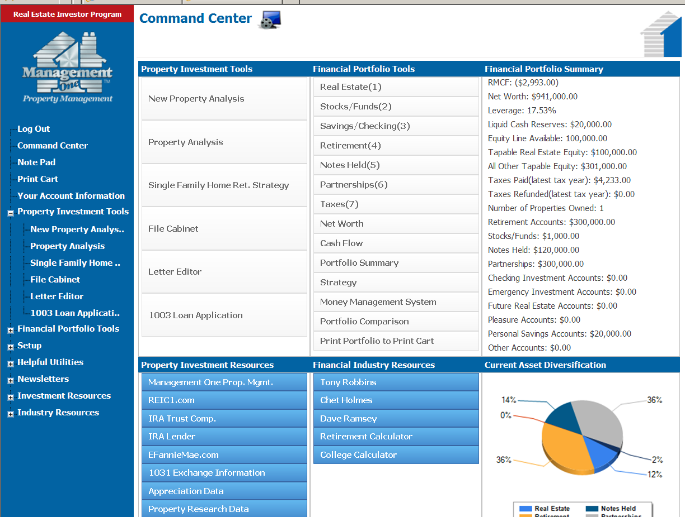
Manage and Track Each Of Your Clients Portfolios’ With Ease Using Our Real Estate Planning Software

Slide 35
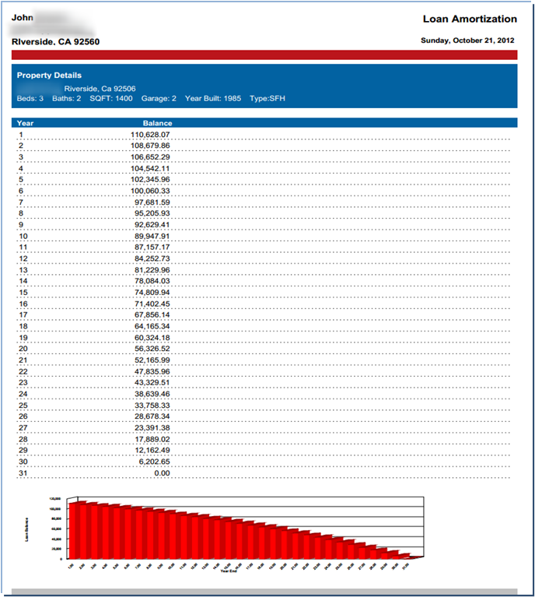
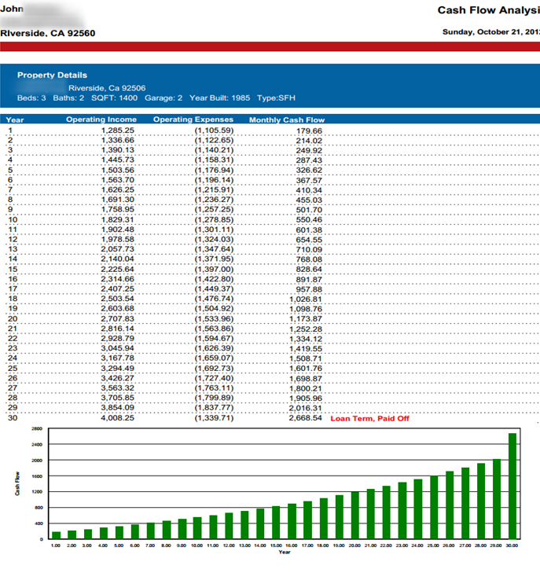
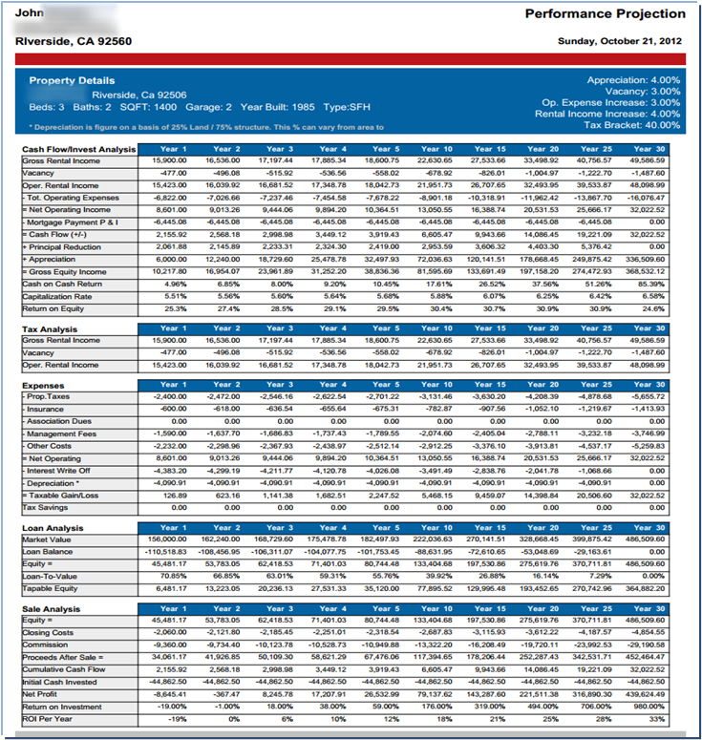
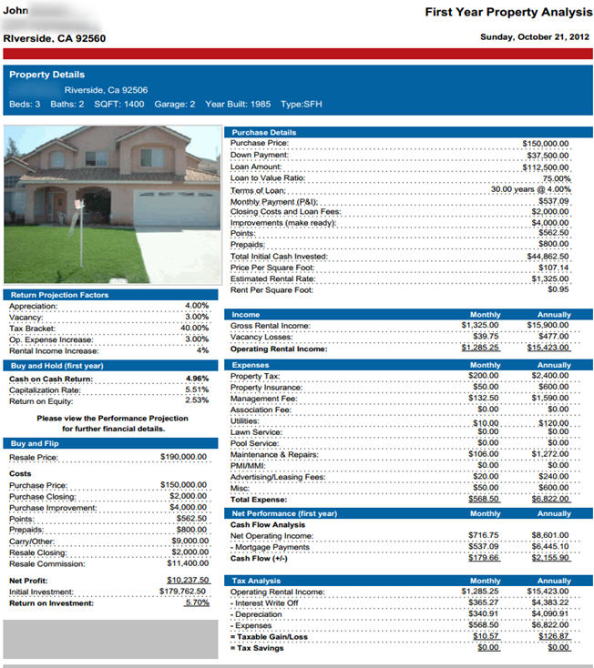
Property Investment Analysis in 5 minutes

Slide 36
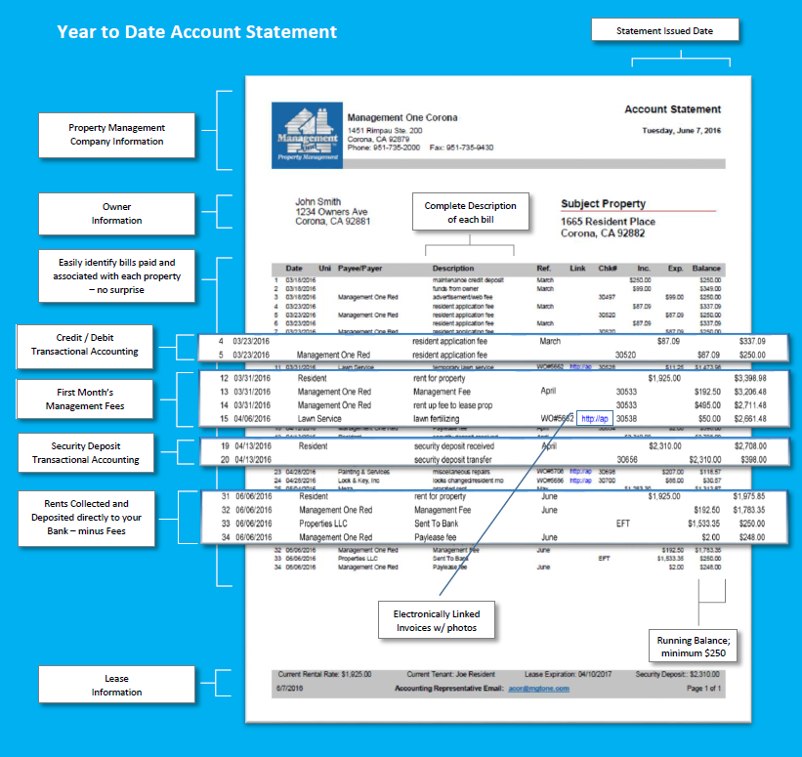
Financial Statements
Monthly Owner
Statement
Management One Beach Side
620 Newport Center Dr. 11th Fl
Newport Beach, Ca 92660
Phone: 949-721-6695 Fax: 949-721-6686
Electronic Access
Year-to-Date
Cash flow Statement
Year-End 1099

Slide 37
Rent Ready Inventory In Many Cases
VISTA CONEJO, MORENO VALLEY CA
4 BED, 2.5 BATH, 2400 SF
LIMECRST, RIVERSIDE (ORANGECREST)
4 BED, 3 FULL BATHS, 1922 SF
MISSON GROVE, RIVERSIDE
4 BED, 3 BATH, 2610 SF
MANAGED 13 YEARS
CURRENT RENT $1820
CURRENT RENT $1975
CURRENT RENT $2175
MANAGED SINCE 1998
MANAGED 8 YEARS BY MANAGEMENT ONE
MAINTENANCE HISTORY AVAILABLE
MAINTENANCE HISTORY AVAILABLE
MAINTENANCE HISTORY AVAILABLE

Slide 38
What you will be able to offer your clients
One hour free to sit down & see if it our SFHRS works for them personally
Find the property for them to buy
01
02
03
Provide a certified rental rate before you make the offer from Management One
04
Make & negotiate the purchase for them.
Set up the financing for them
05
Take it all the way through escrow
06
Make it rent ready with repairs, painting, etc through Mgt One & our fixed maintenance prices
07
08
Rent the property through Management One
09
Professionally manage the property & even provide guaranteed eviction coverage for them
10
Provide software for your clients to track their investments & for you to track them

Slide 39
Wrapped up in one neat tool box
Real Estate
Investment Planning
For YOU

