Slide 1
RESIDENT SERVICES
Powered by
MANAGEMENT ONE
Property Management

Slide 2

Partnership Agreement
(We Each Have A Role To Play)
Management One
Owner
Manages the resident
Manages cash flow
Leasing
Repairs
Inspections
Accounting
Move out of property as agreed if currently living in property
Remit funds timely when needed
Respond within 48hrs of contact
Obtain the proper property insurance
Vendor
Resident
Must be licensed & insured
Must give timely service to resident
Give estimates as needed
Agree to our pre-set maintenance pricing
Maintain property
Pay rent on time
Notify us of repairs

Slide 3
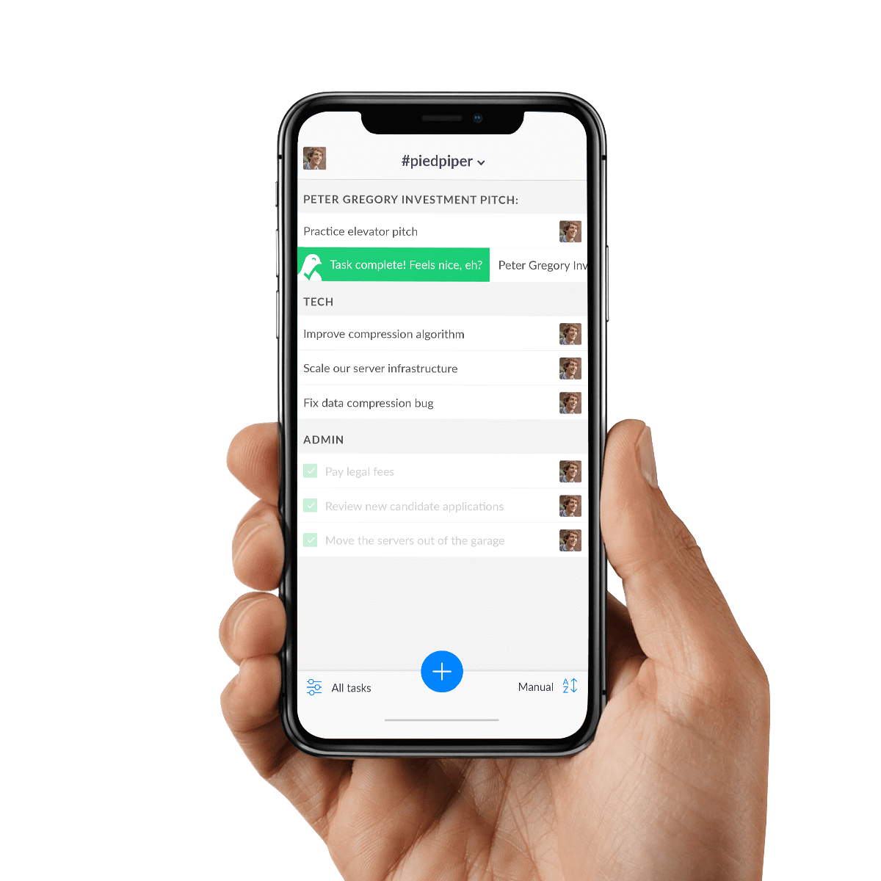
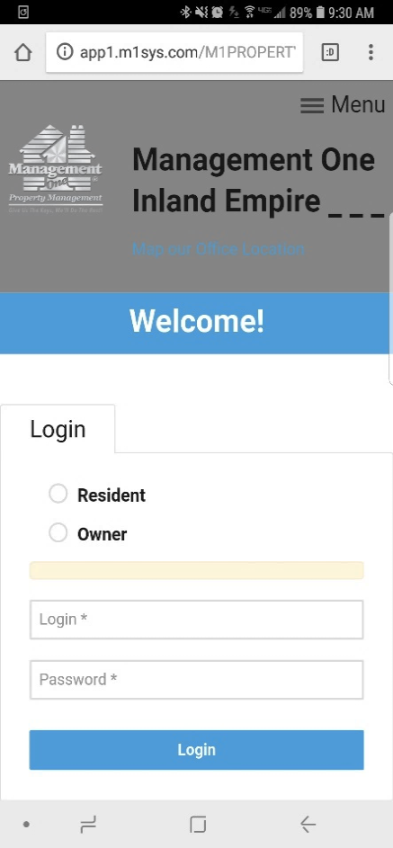

Place a Shortcut on Your Home Screen
Step
01
Type in www.managementone.com. to your smart phone
Step
02
When it comes up, just press the button on your smart phone that says “add to home screen”
Step
03
Now you have an “app” with one touch service just by pressing the Management One Icon

Slide 4

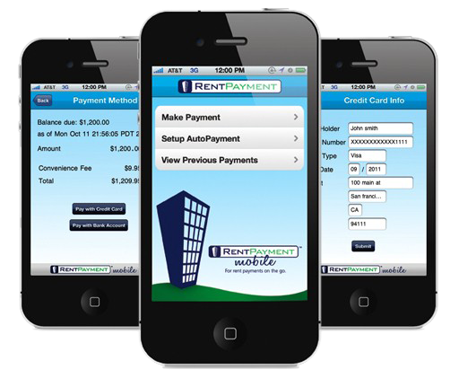


Rent Payments
Pay Rent Online
01
We do not accept any personal checks or cash
02
PayLease Is Preferred

Slide 5

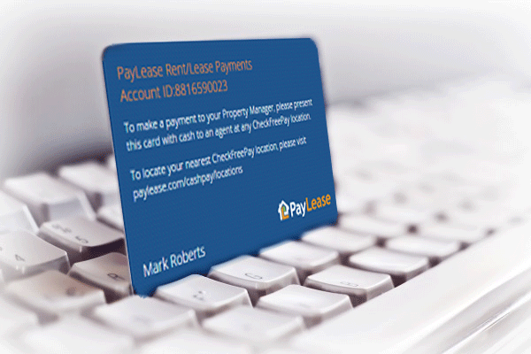




Rent Payments
Pay at Convenient Locations
ACE CASH EXPRESS

Slide 6
Late Fees
Rent is due the 1st
Per Calif Law Delinquent on the 2nd, Management One
^{gives} ^{until the 5th at midnight}
01
On the 6th @ 12:01am you are late
02
03
Late Fees are calculated at 5% of Rent, plus $50 3 day posting fee, plus $5 a day
04
Exam: One day late on rent on $1500 is $130

Slide 7


Pet Approval?
If your lease calls for outside pets they must remain outside to avoid a violation fine and possible termination of the lease
If you want to add a pet you must get approval in writing first with deposits and the required Pet Rent

Slide 8
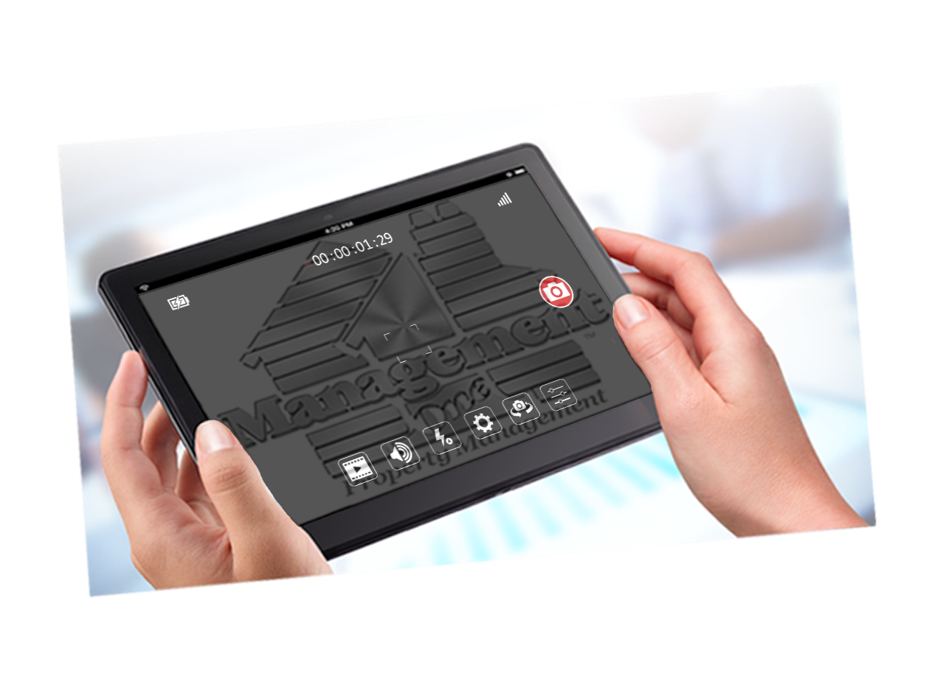




Before you move in, a 200-point inspection was completed
Inspected and Video Taped
Each Room In Detail for your protection

Slide 9


Property Condition
The Rent Rate is Commensurate with a pre-owned property
While things will function, they won’t look or function like a brand new property
Brand NEW Properties, Rent for More
Typically A New Property Rents for $500 more than
a pre-owned property.

Slide 10
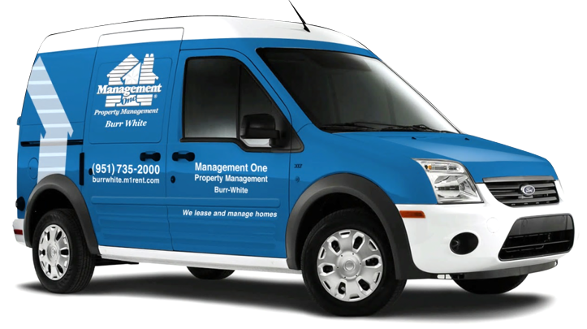
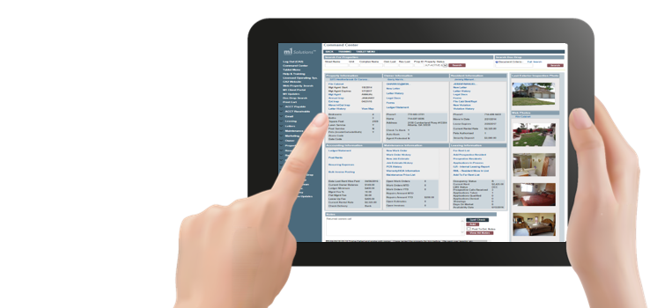
Types of Inspections
Move in Inspection
Monthly Exterior Inspections
Annual Inspections

Slide 11

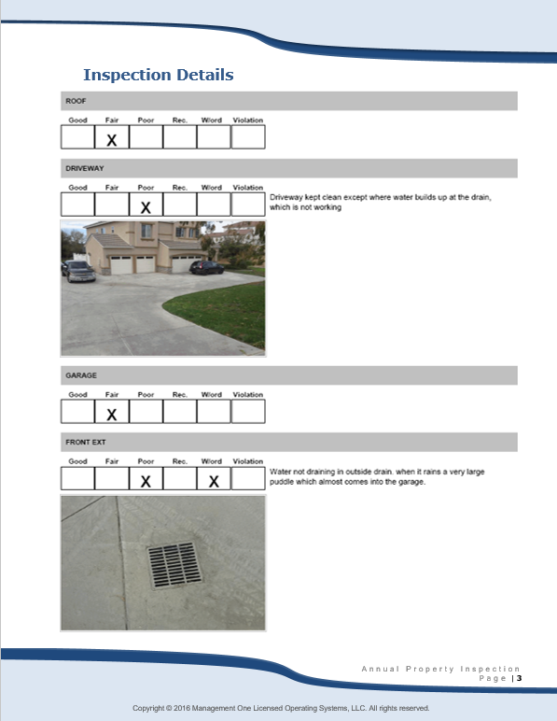
Annual Property Inspection
Annual Inspections
Required by the owner of the property

Slide 12
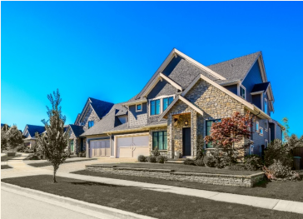
Property Standards
Not Acceptable
Turning off the water
Turning the sprinkler time down resulting in a lack of water
Not fertilizing the yard twice a year
Lack of Maintenance will result in a gardener being added at your expense
Acceptable

Slide 13

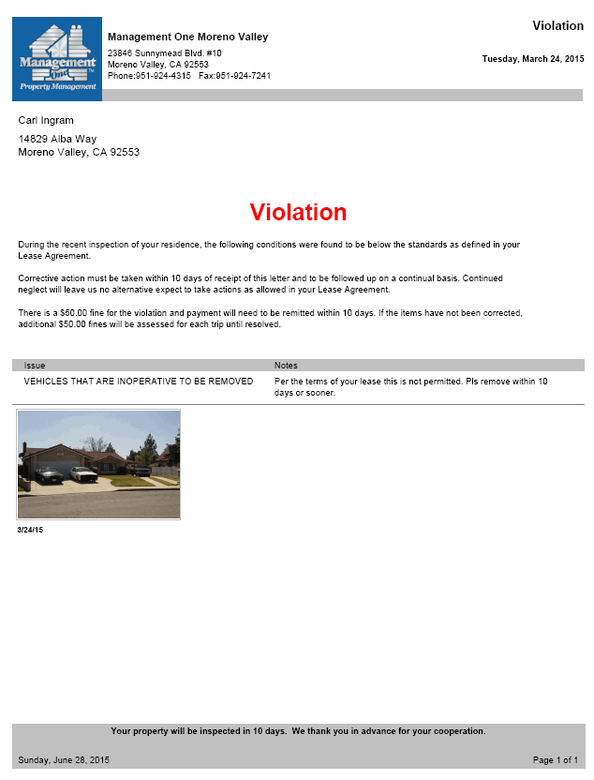


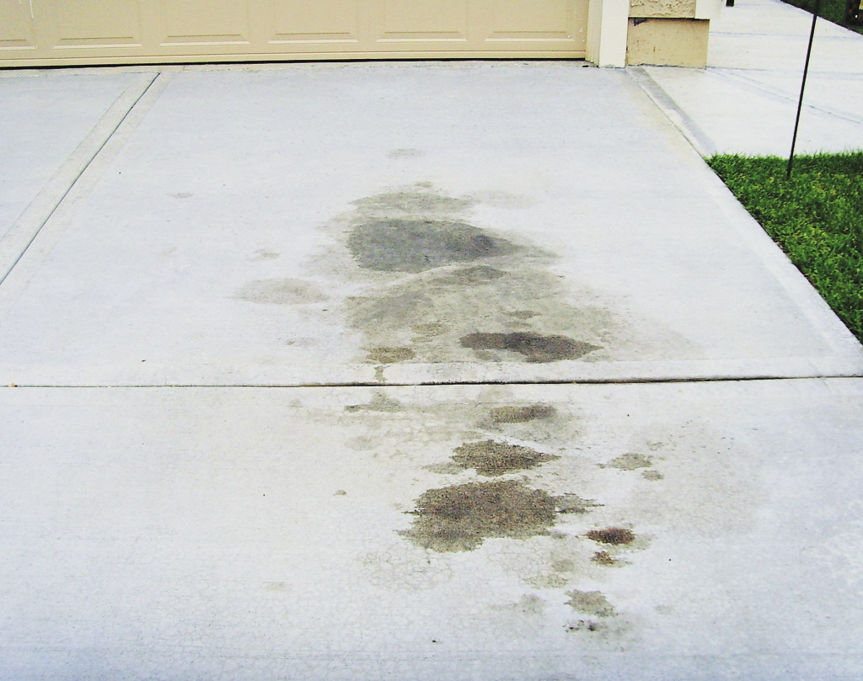
Avoid Violation Fines of $50, $100, $200
Violations Are Issued for these & more:
Dry Lawns (even in drought conditions)
Landscaping not mowed, edge, fertilized
Weeding of flower beds
Parking on the Grass, Rock, Etc
Inoperable Vehicles
Trash cans left out front
Basketball hoop stands left out front
Oil Spots or stains

Slide 14

Emergency Repairs
What Consists of an Emergency???
Electrical Wiring (power failure & resetting breakers are not an emergency)
Hot Water Heater leaking or not working
06
01
Broken pipe inside the house (not a sprinkler line outside)
Broken entry door & locks leading to the outside
05
02
04
03
Gas Leak (Call Gas Company)
Sewer Backup

Slide 15

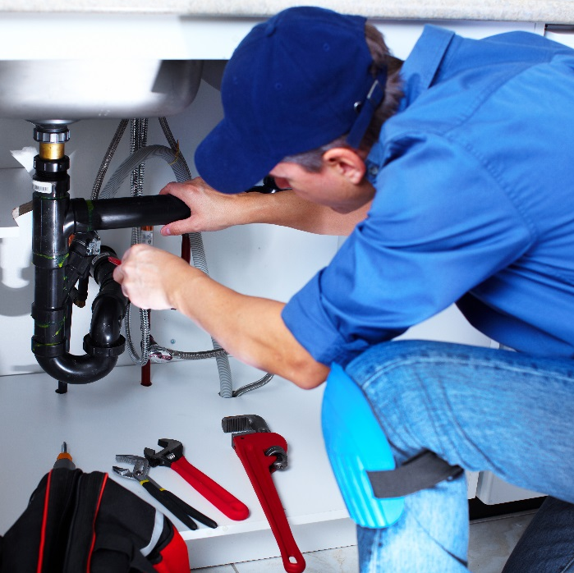
Maintenance Repairs Process
Management One does not own the property
01
Majority of non emergency repairs will be completed within 5-14 days
General Maintenance Information
04
02
Our repairmen are not actual employees of Management One but rather sub contracted
03
We can only authorize maintenance repairs up to $ 250 without receiving funds from owner/owner approval

Slide 16


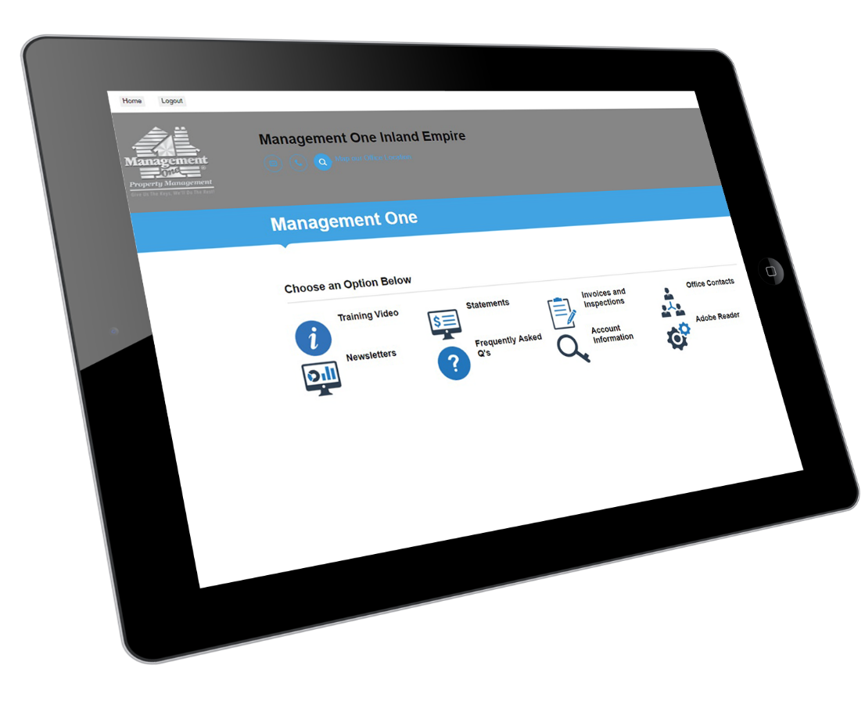

Online Maintenance Requests

Slide 17
Step by Step Procedure on Maintenance Repairs
5
You and the repairman will set a time to have the repair done.
4
You agree to respond back to the repairman asap no more than 24 hours.
3
Repairman contacts you with 24 hours – Mon- Fri
2
You call or e-mail a maintenance repair request to our office from your personal portal.
(Show Portal Now)
We dispatch the work order to our outside repairman
1
If you call in a repair and then fail to cooperate timely with the vendor within 24 hours the work order will be canceled. To reschedule a 2nd time to have the repair done there is a $25 admin fee to cover overhead
If you miss an appointment scheduled with a repairman there is a $40 trip charge to you for the service call.

Slide 18

Customer Service Accountability
Help make us better…
When you have a repair let us know how our repairmen did…
01
02
03
04
Did the repairman show up on time?
Were they professionally dressed?
Was the repair completed 100%?
Did the repairman clean up after the repair was made?

Slide 19

Repairs under $50.00
Grass seed for the yard
Fertilizer for the yards twice a year
Wooden boards for the fence
Rollers on the screen doors
Air Conditioner/heater filters
Batteries for smoke detectors
Door Bell
Sprinkler heads replaced (providing it’s owner responsibility)
Garbage disposal
Rollers for closet doors
Electric and cable socket covers
Door Stoppers
Do not deduct from the rent, turn in receipt and you will be reimbursed in 30-45 days**

Slide 20


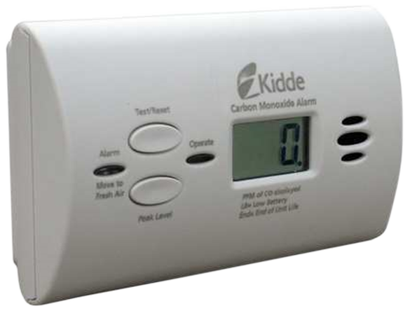
7 People a day die in fires. DO NOT REMOVE

Slide 21
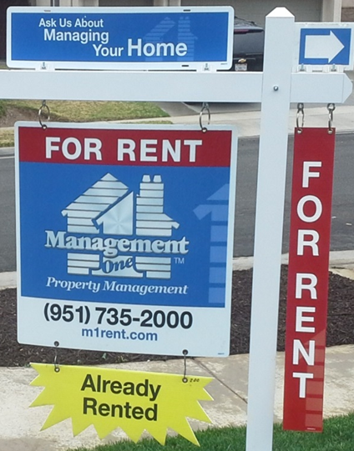
Please……
DO NOT REMOVE SIGN
$200 Fine for Sign and LBX Removal
Sign will be removed upon move in inspection

Slide 22
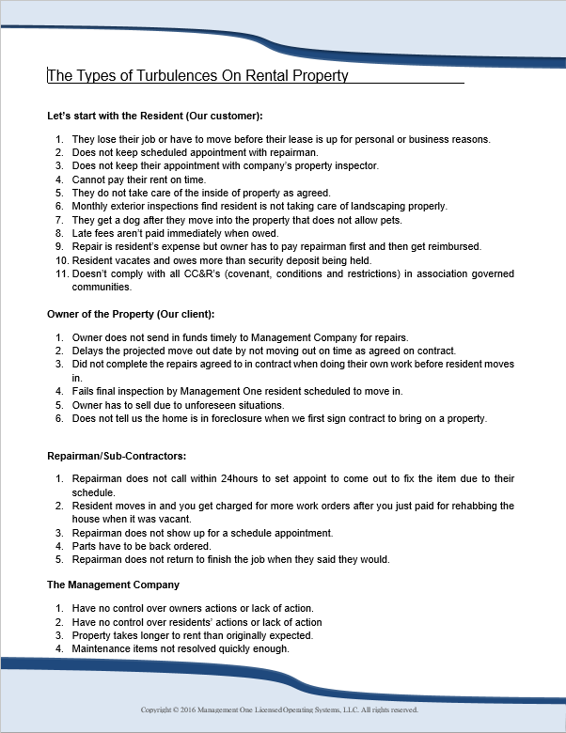


Turbulences that may occur
Ladies and Gentlemen serving Ladies and Gentlemen
Knowing the unknown will keep you happy!
Not Knowing will leave you frustrated

Slide 23

Renters Insurance
The Company requires Renters Insurance before Move In
You get up to $10,000 to $25000 for personal belongings coverage
Up to $300,000 in damage to the property caused by you – Very important
Displacement coverage

Slide 24
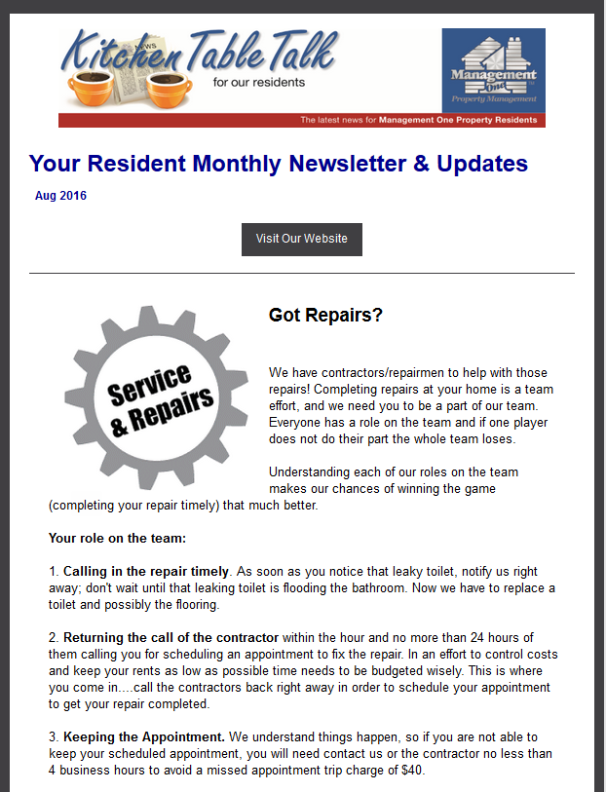
Resident Newsletter
Tidbits on maintaining your home
Notifies you of up coming events
Real time information

Slide 25

Your KEYS To Your New HOME
You are responsible to turn all of them in when you decide to move out.
We give you 2 sets of keys
Mail key (you may have to get from post office take your rental agreement)
Garage Remotes
Pool Keys in HOA’s
FOBS if gated community

Slide 26


Welcome to the Management One Experience & Enjoy your New Home

