Slide 1
management one
Property Management

Slide 2
Management One’s Structure
People
Process
Profits
Pleasure
Systems Command Center
Office Design
People
Processes
Profits
Pleasurable
Systems
Training
Goals
Our Culture
management one
Property Management
Notes:
.

Slide 3
Staff Efficiency
Team players are required to complete:
A) The First 100 Days of Training
B) 12 weeks on the job
training
C) Must past all written test
with a 90% rating plus
D) Must have management
approval before working
with clients
management one
Property Management

Slide 4
The KASH Model
Knowledge
It is the basis of enthusiasm and confidence. Knowledge is the fuel for desired
performance and productivity
Attitudes and Beliefs
Attitudes and Beliefs affect all actions and levels of Production
Skills
Skills need to learned in structural training and practical experience
Habits
Successful Habits of high performance are developed through repeated behavior in
environments that support and reward that behavior
Training becomes truly powerful when these KASH principals are used
management one
Property Management
Notes:
.

Slide 5
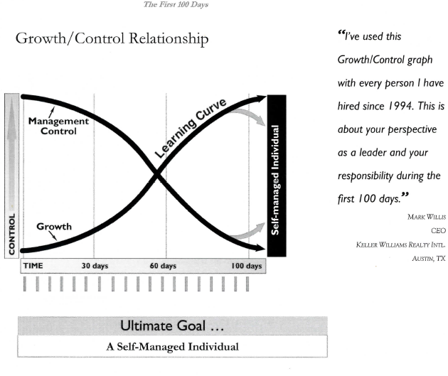
First 100 Days
management one
Property Management

Slide 6
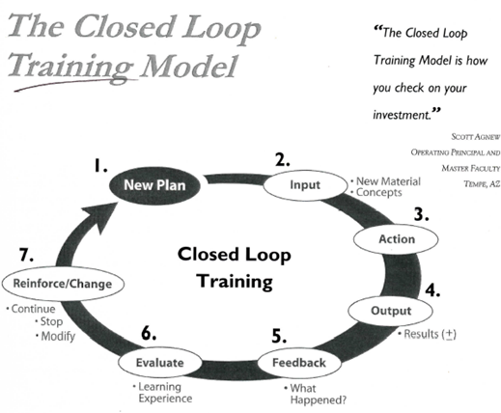
Closed Training Loop
management one
Property Management

Slide 7
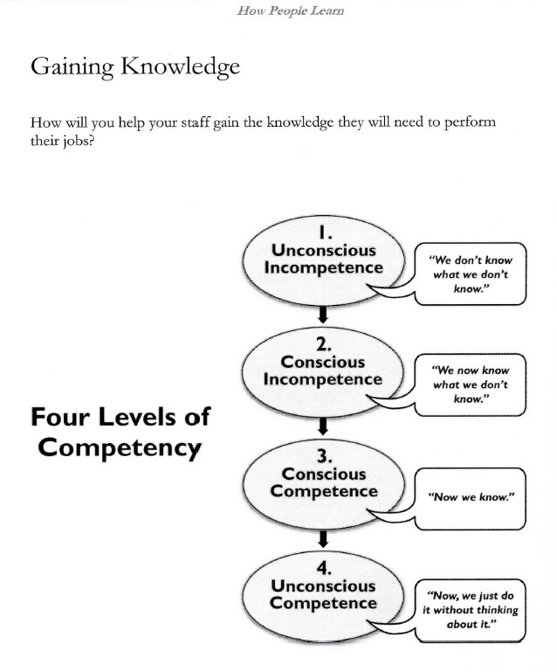
Competency
management one
Property Management
Notes:
.

Slide 8
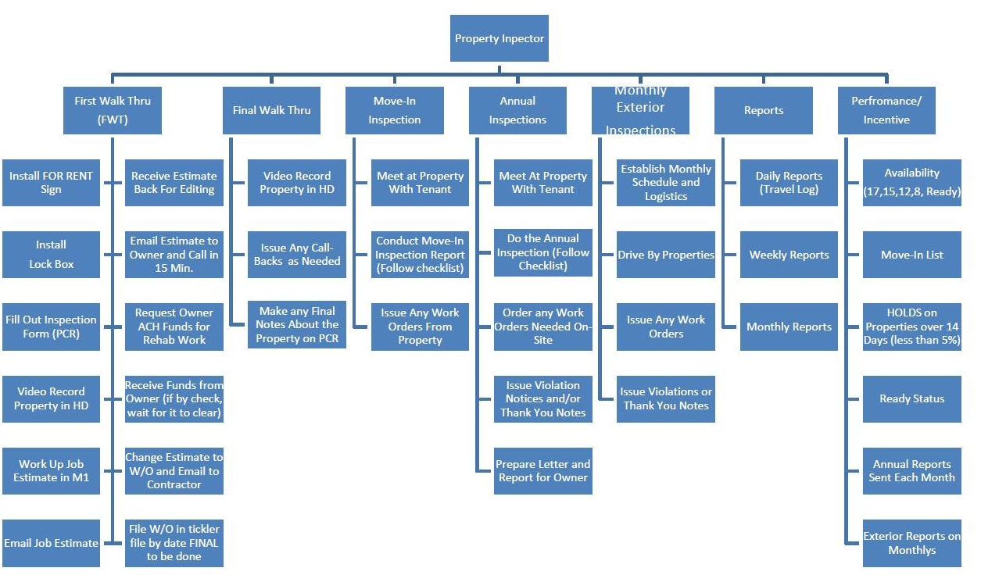
Job Descriptions in each Division
management one
Property Management
Notes:
.

Slide 9
Management One
m1software
Proprietary Property Management Software
management one
Property Management
Notes:
Replace this text with your prepared letter to your client.
Keep a general letter here but switch out the client name when applicable.

Slide 10
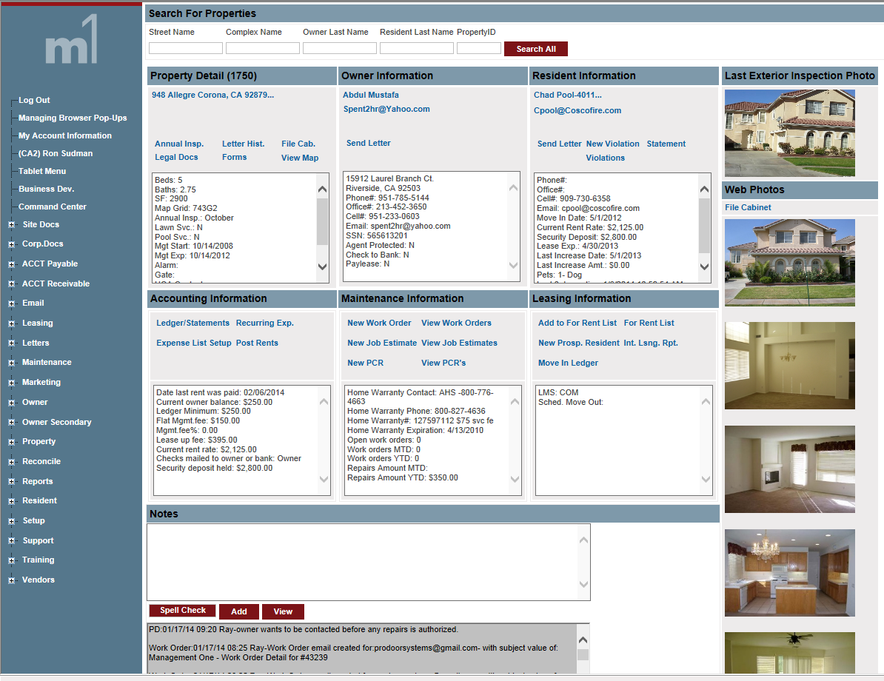
Command Center for m1software
management one
Property Management
Notes:
.

Slide 11
Training / Video’s
Inside m1software
management one
Property Management
Notes:
.

Slide 12
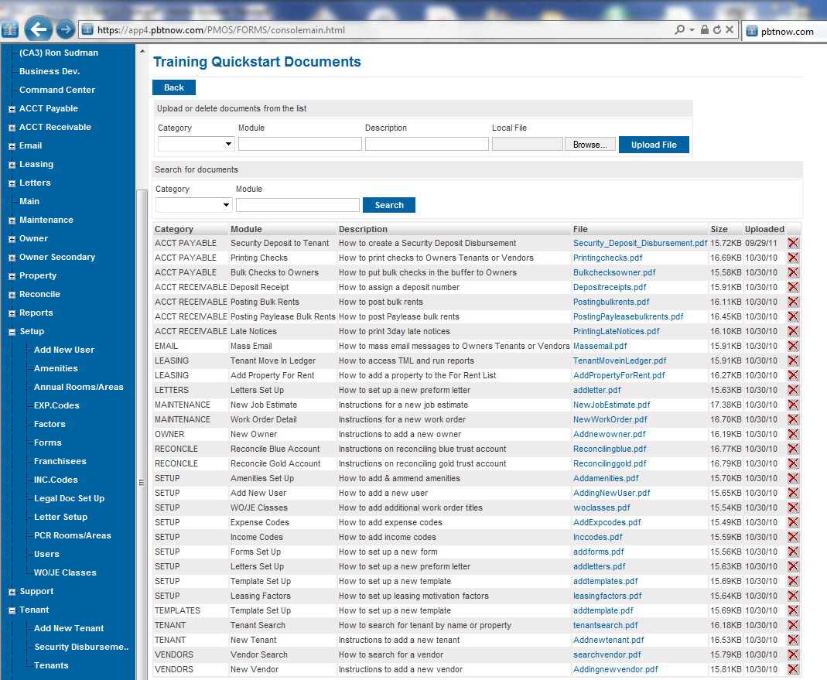
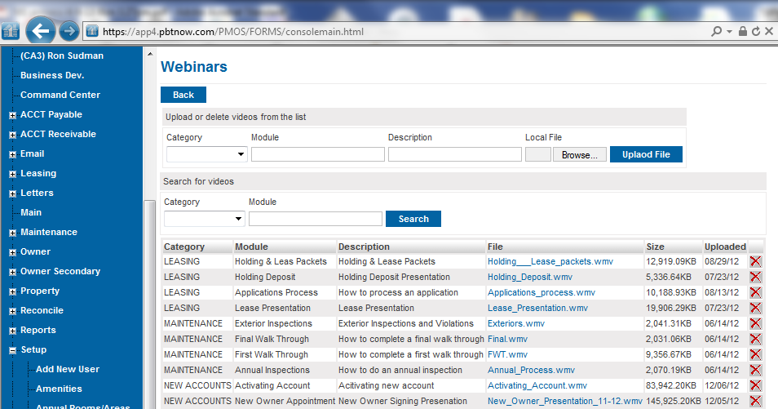
Training / Scripts / Video’s
Inside m1software
management one
Property Management
Notes:
.

Slide 13
Human Resources
Set up and manage Medical Benefits with no administrative overhead
Retirement Benefits with no overhead
management one
Property Management

